Slide 1
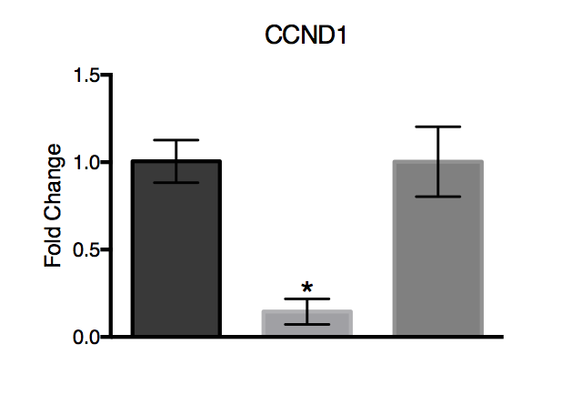
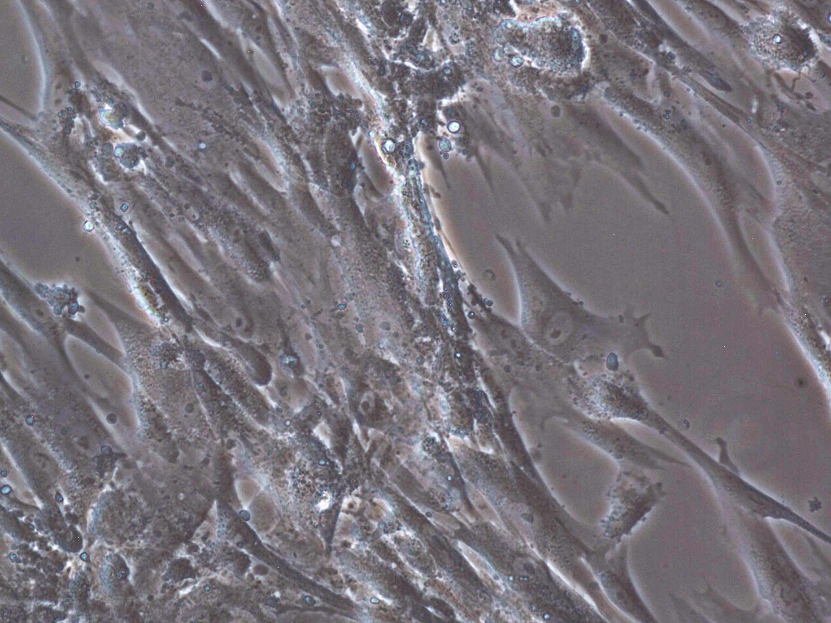
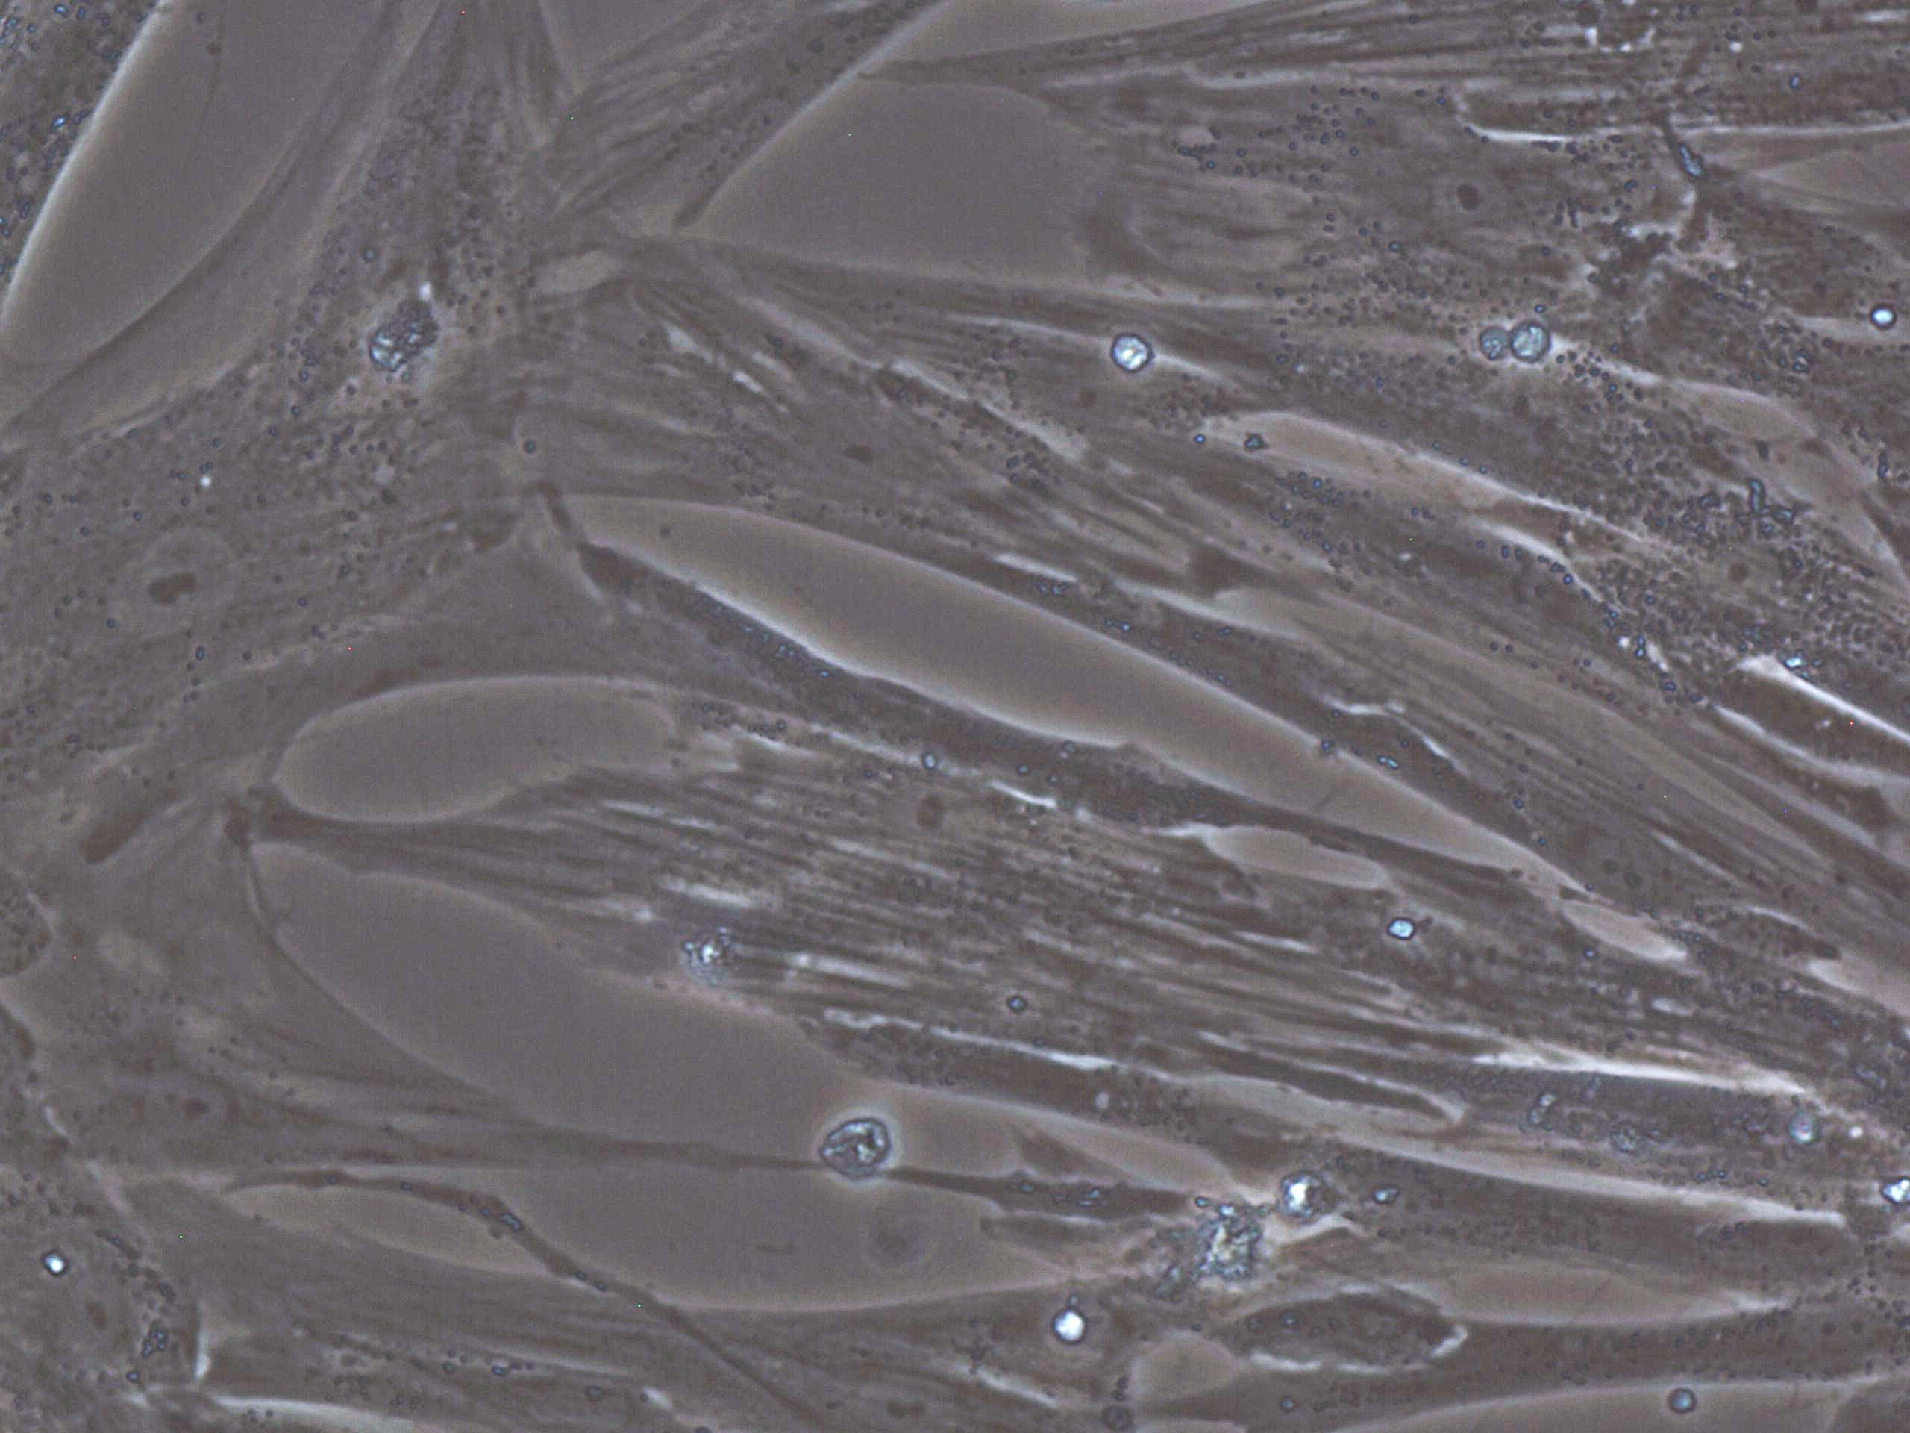
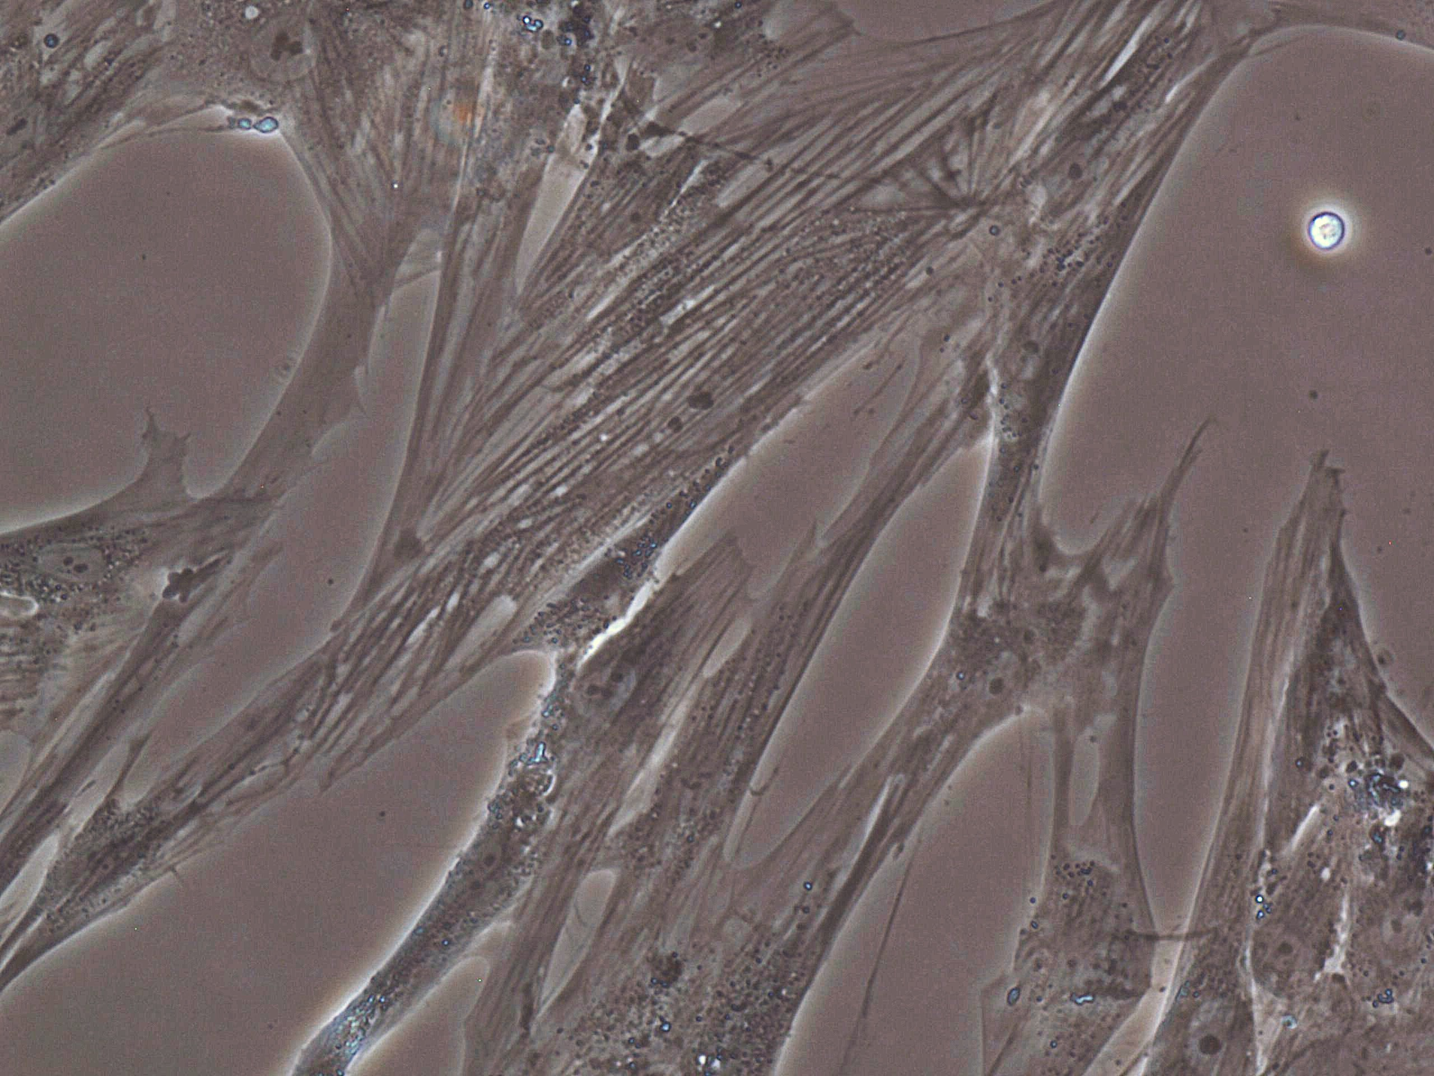
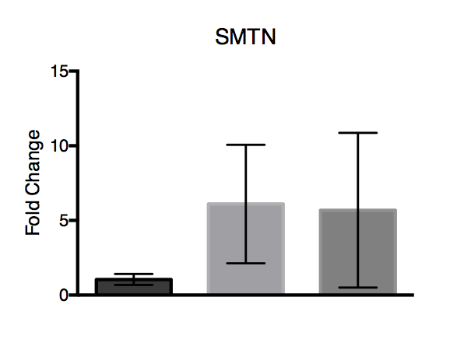
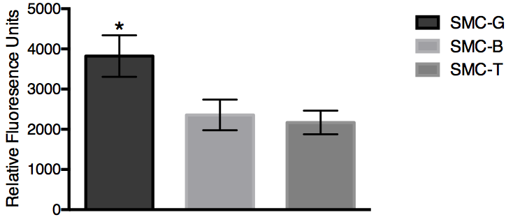
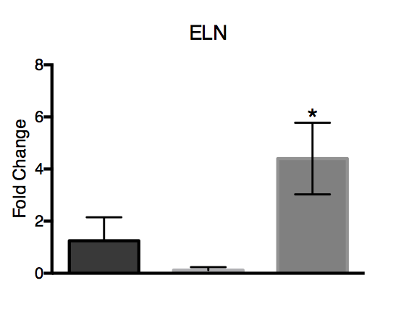
A)
SMC-T
SMC-G
SMC-B
B)
Figure 1. A) Bright field images of SMC-G, SMC-B, and SMC-T on culture day 4 at 20X magnification. B) Analysis of PrestoBlue assay of SMC-G, SMC-B, and SMC-T on culture day 4, *p<0.05 one-way ANOVA
Notes:
20x BF
Rid lines/chartjunk
20x and RFU 1 fig, EDU images A and then graph B in fig2, protein exp fig 3, gene expression fig 4

Slide 2
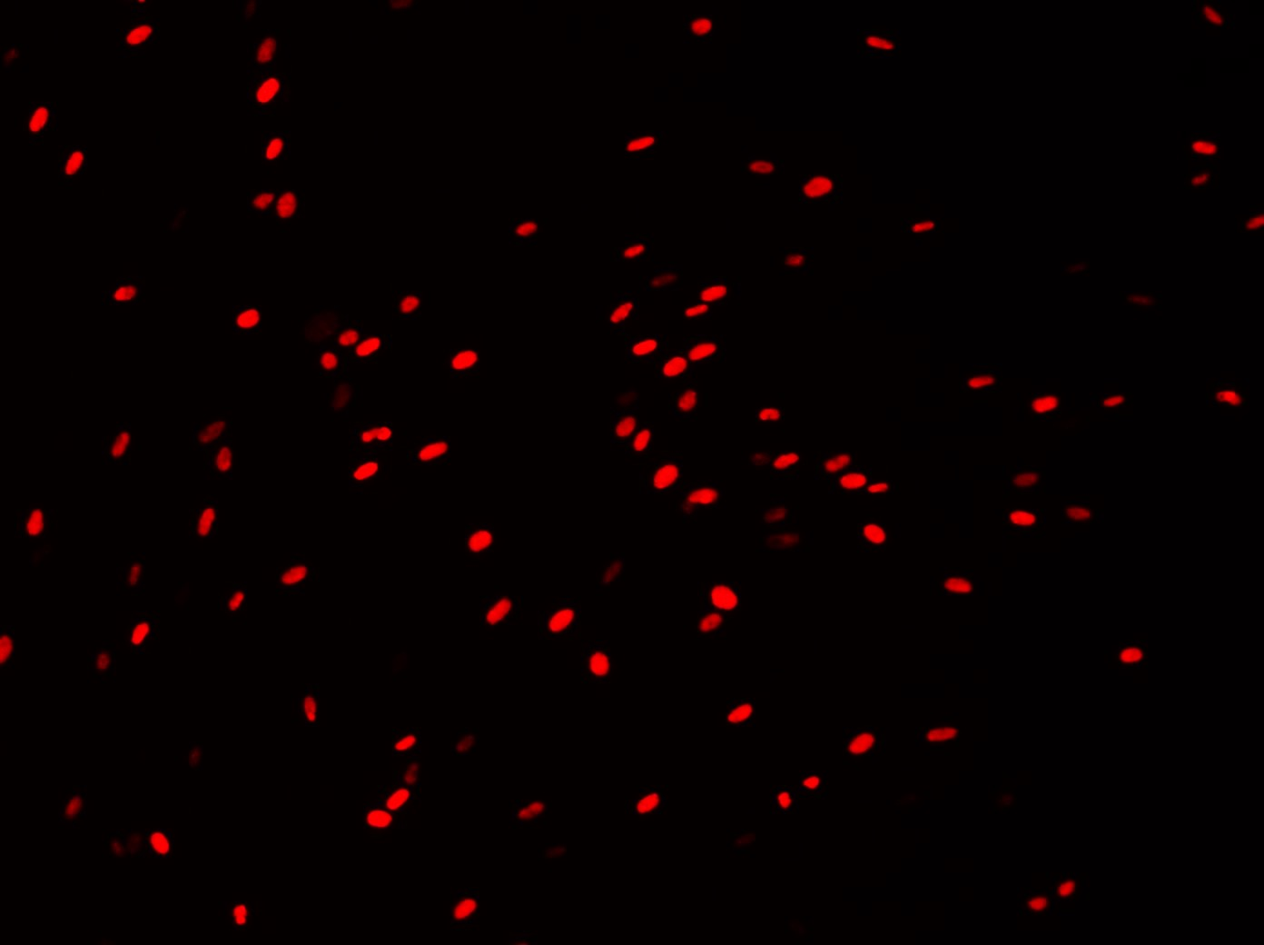
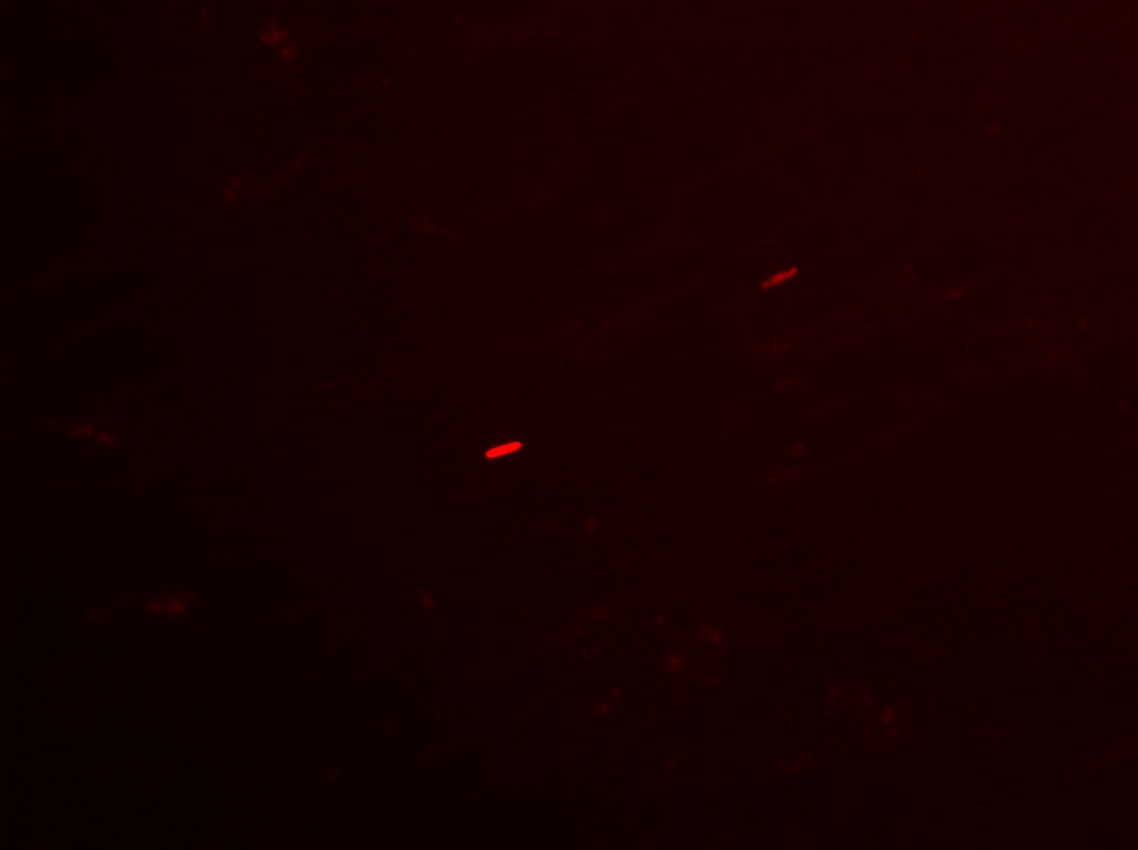
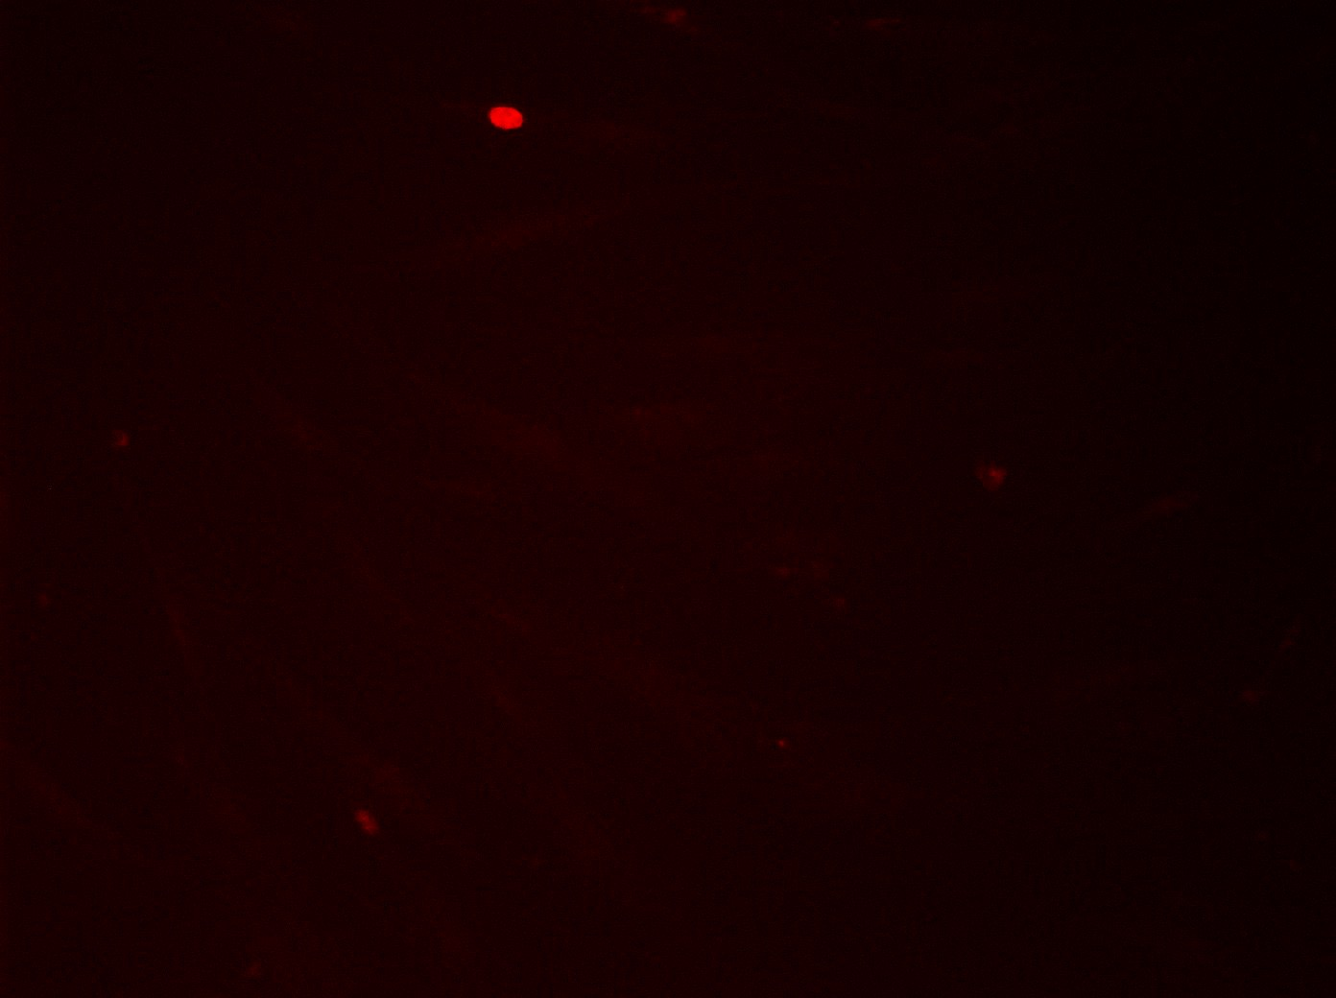
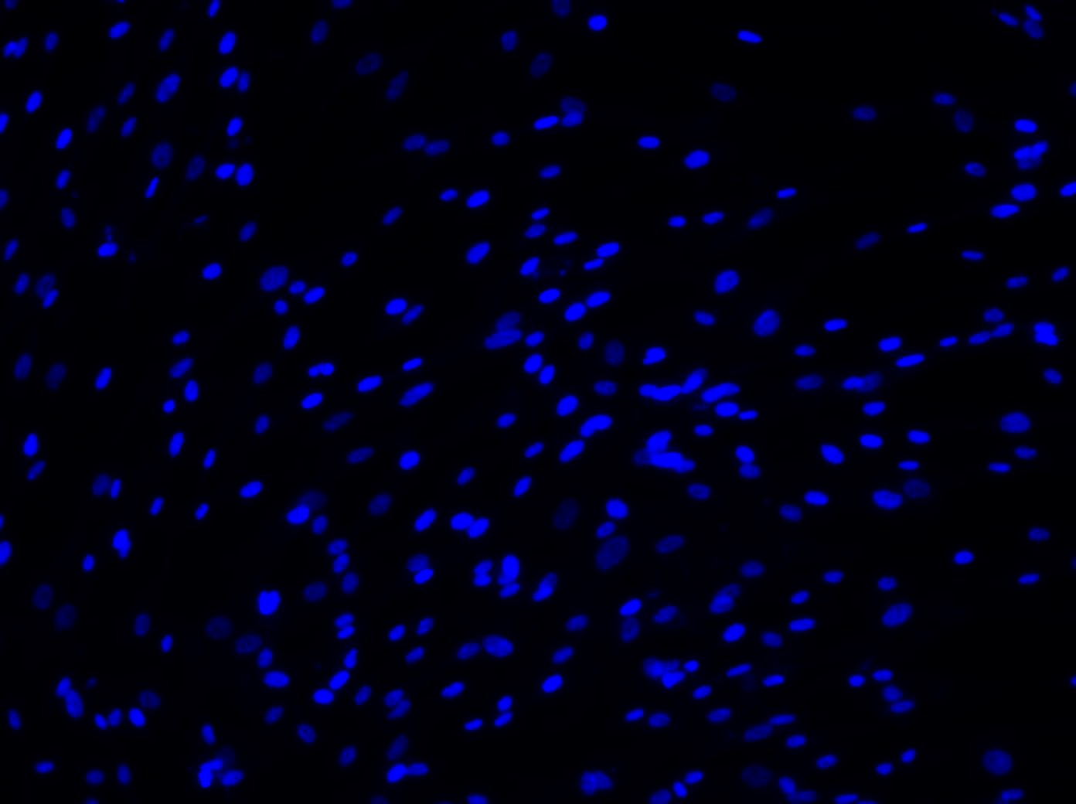
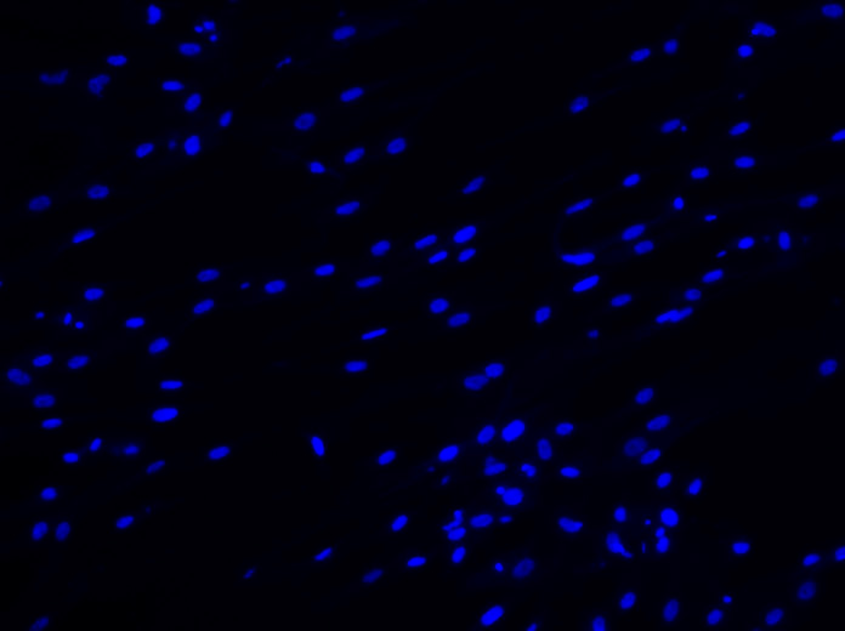
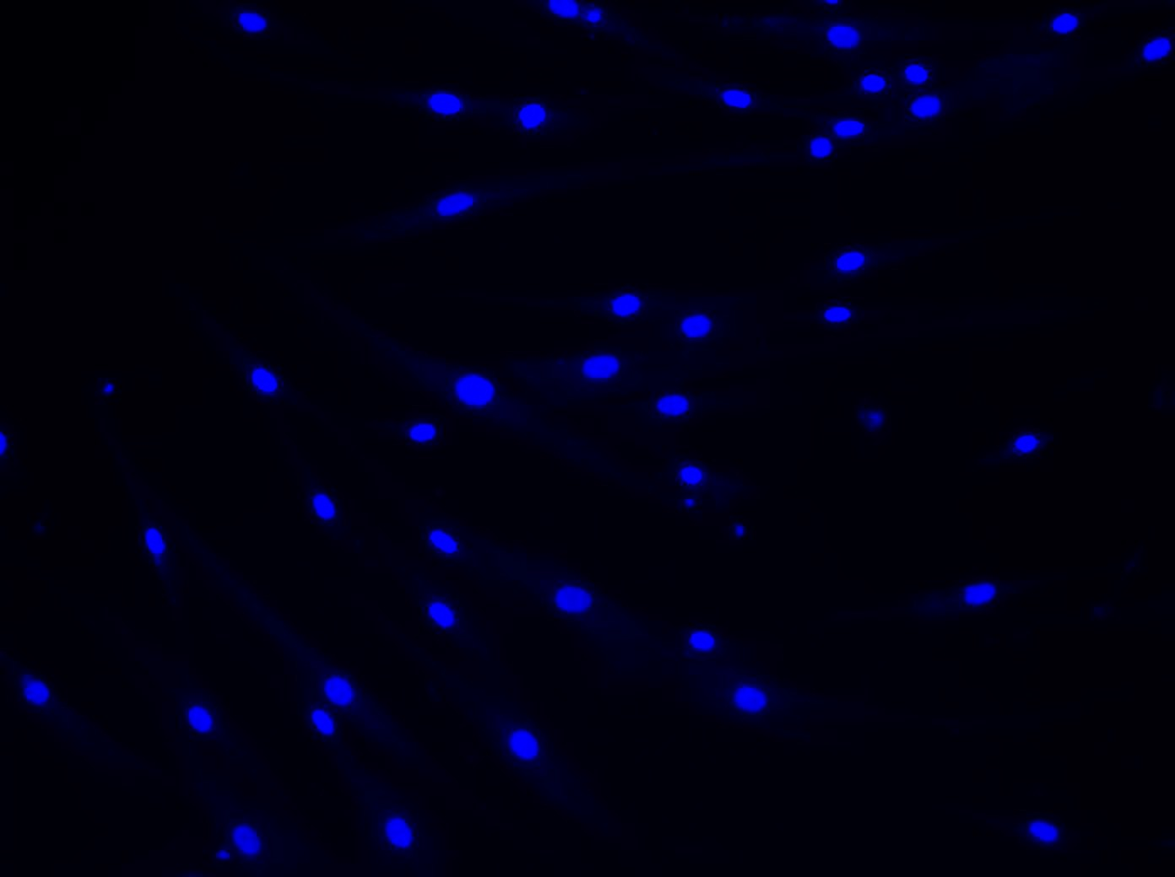
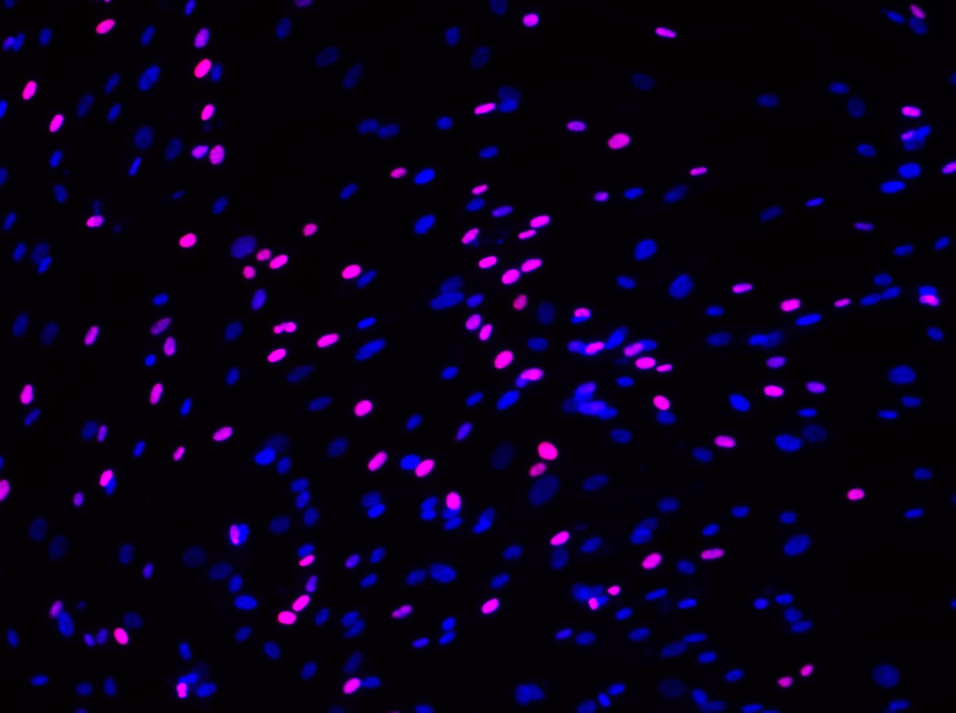
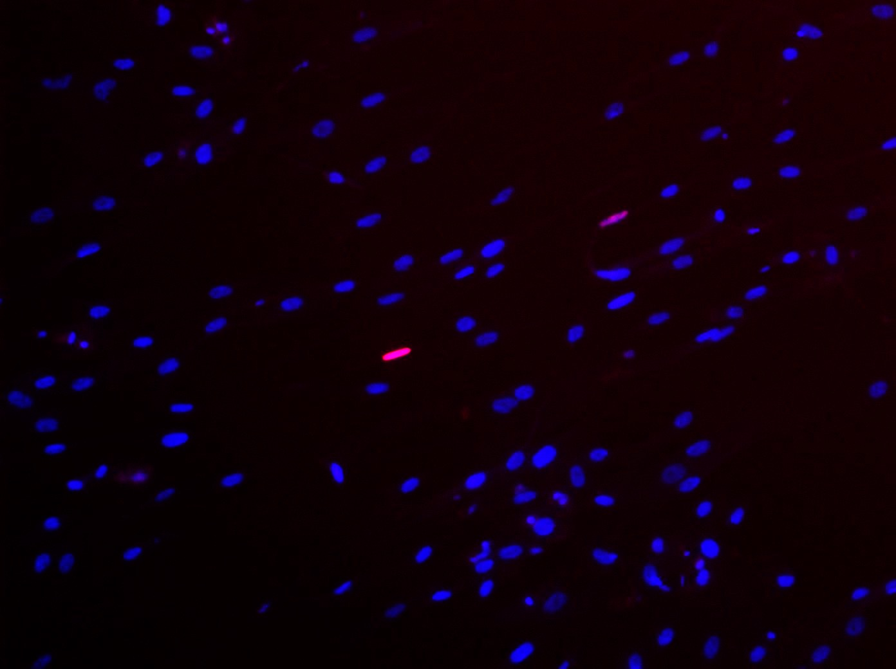
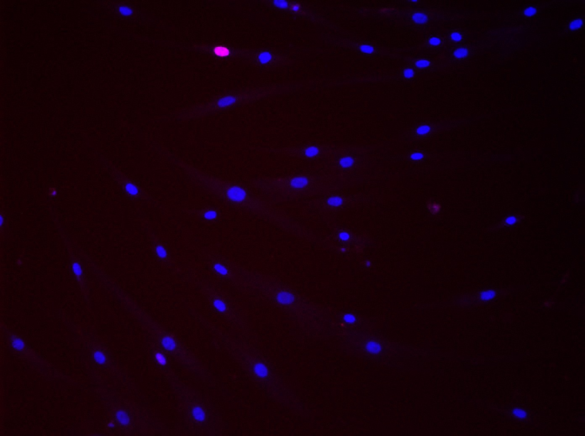
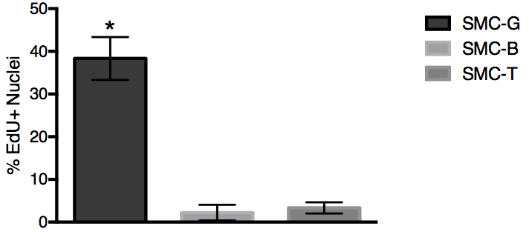
A)
SMC-T
SMC-G
SMC-B
B)
Figure 2. EdU assay of SMC-G, SMC-B, and SMC-T on culture day 4. A) Images taken at 10X magnification showing expression of EdU (top), DAPI (middle), and EdU and DAPI merged (bottom). B) Analysis of the percentage of EdU+ nuclei, *p<0.05 one-way ANOVA

Slide 3
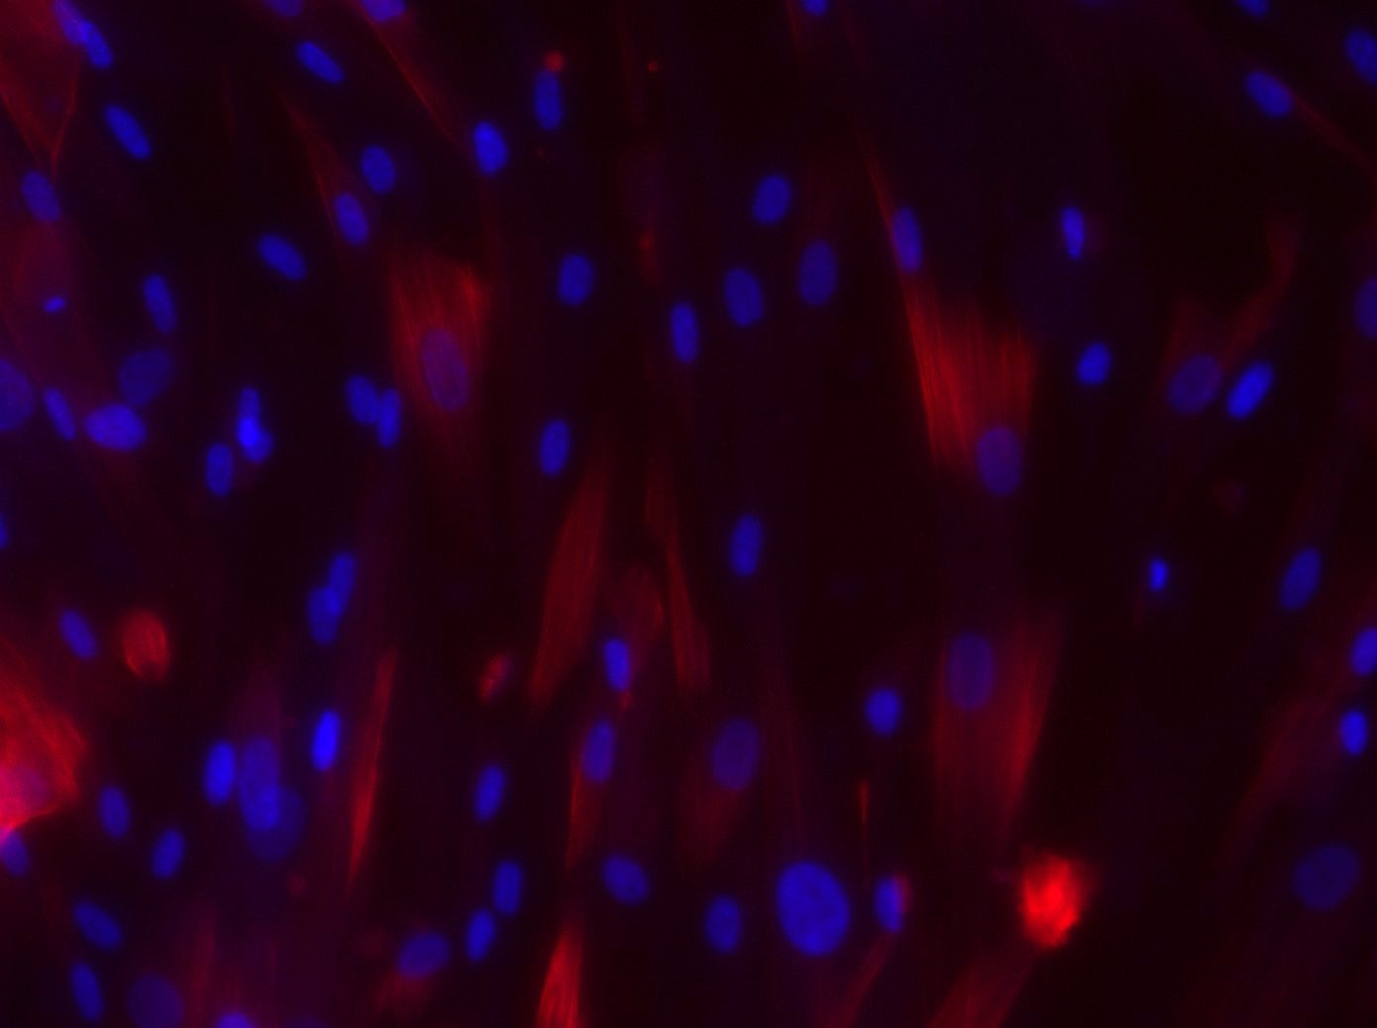
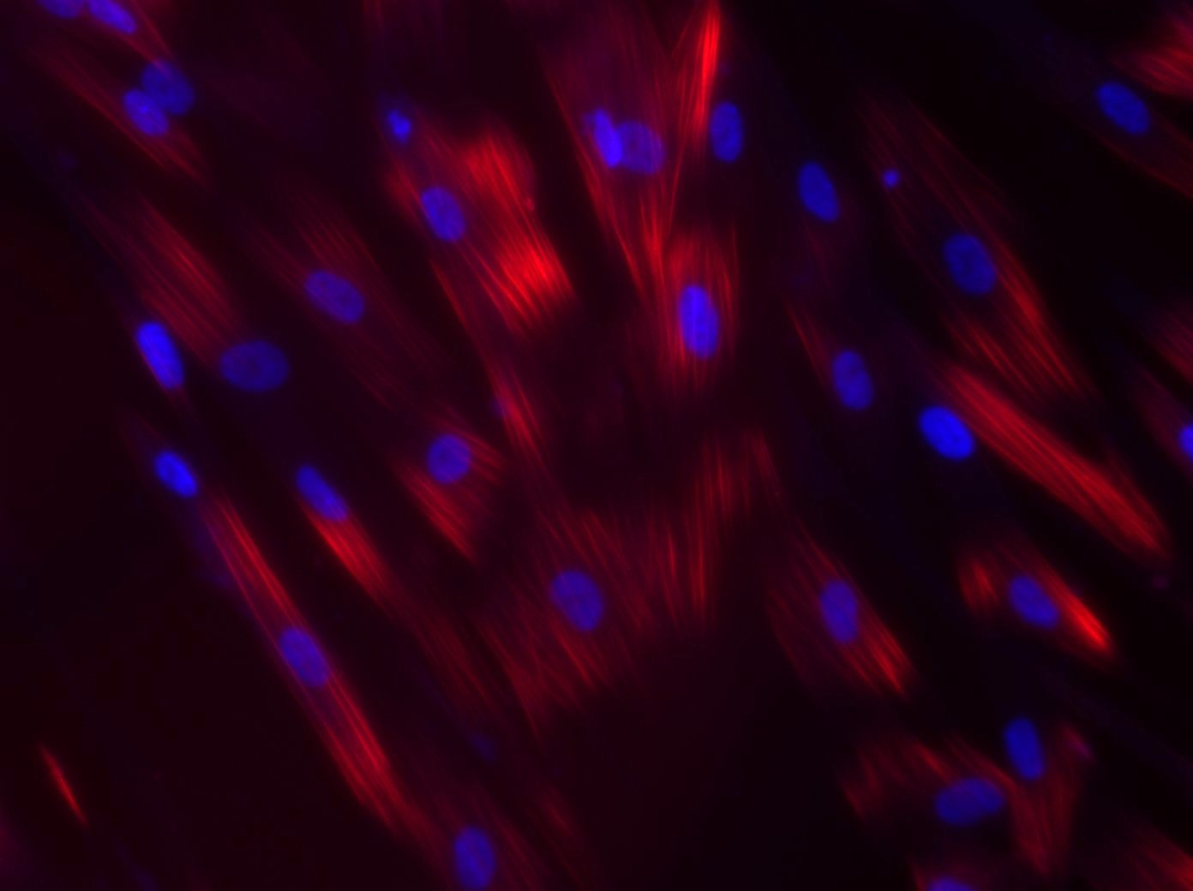
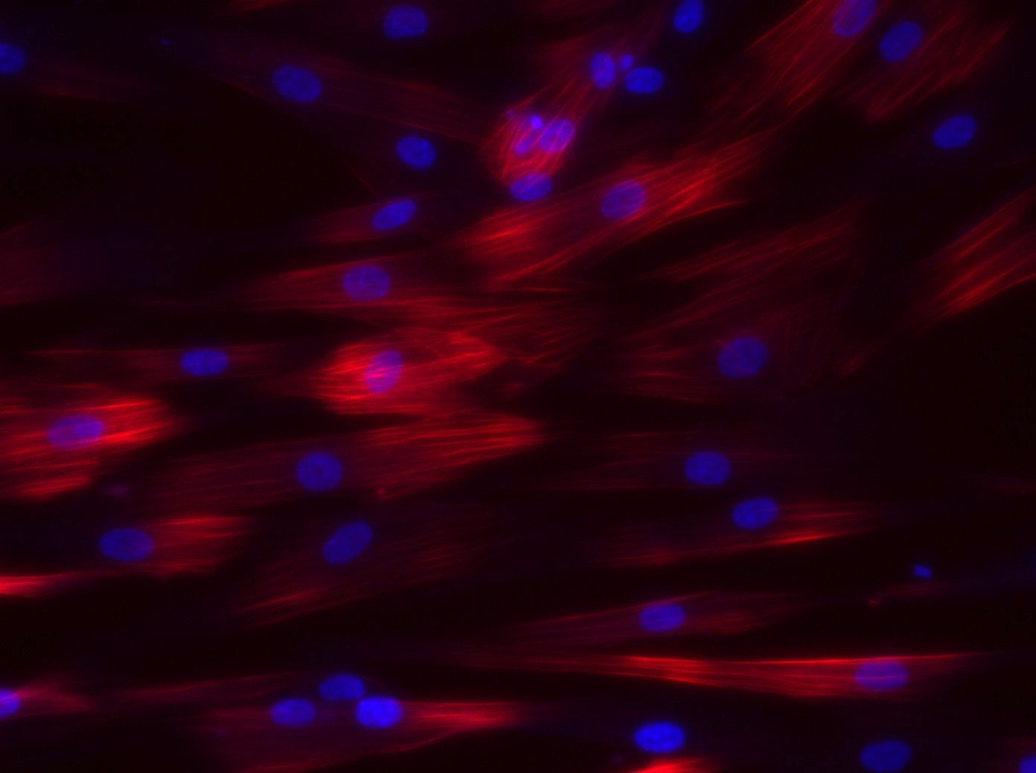
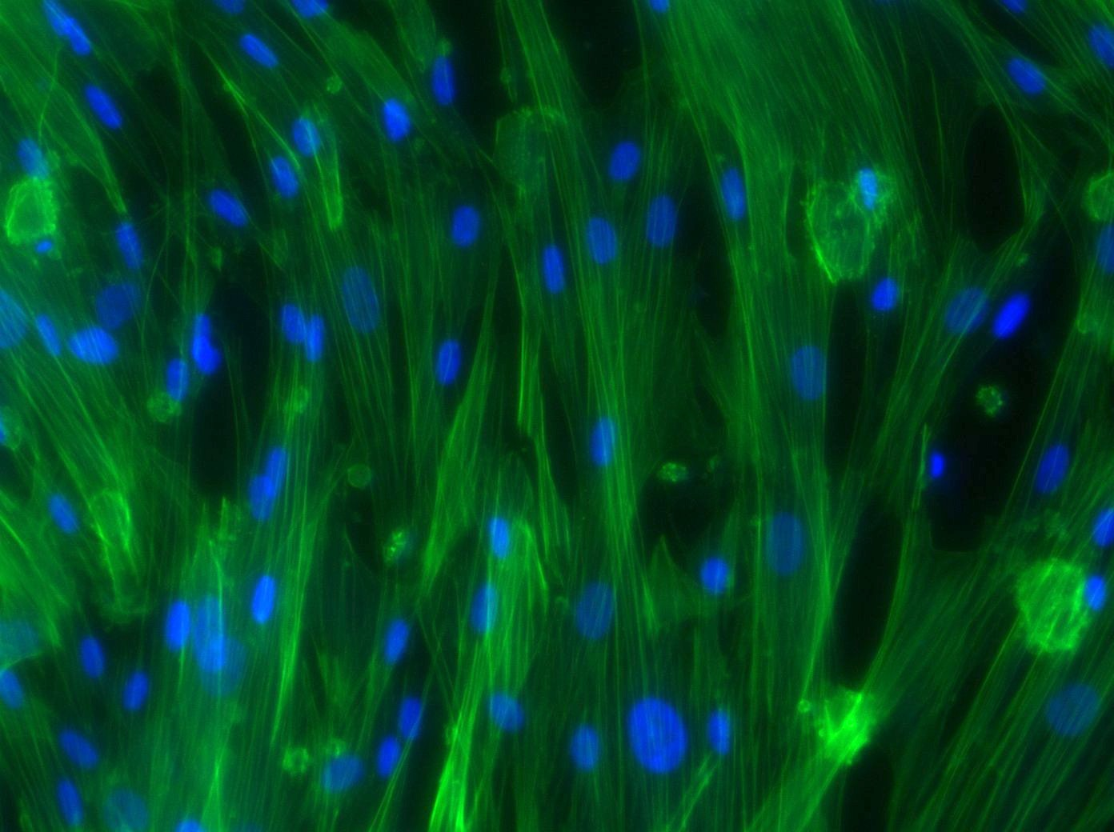
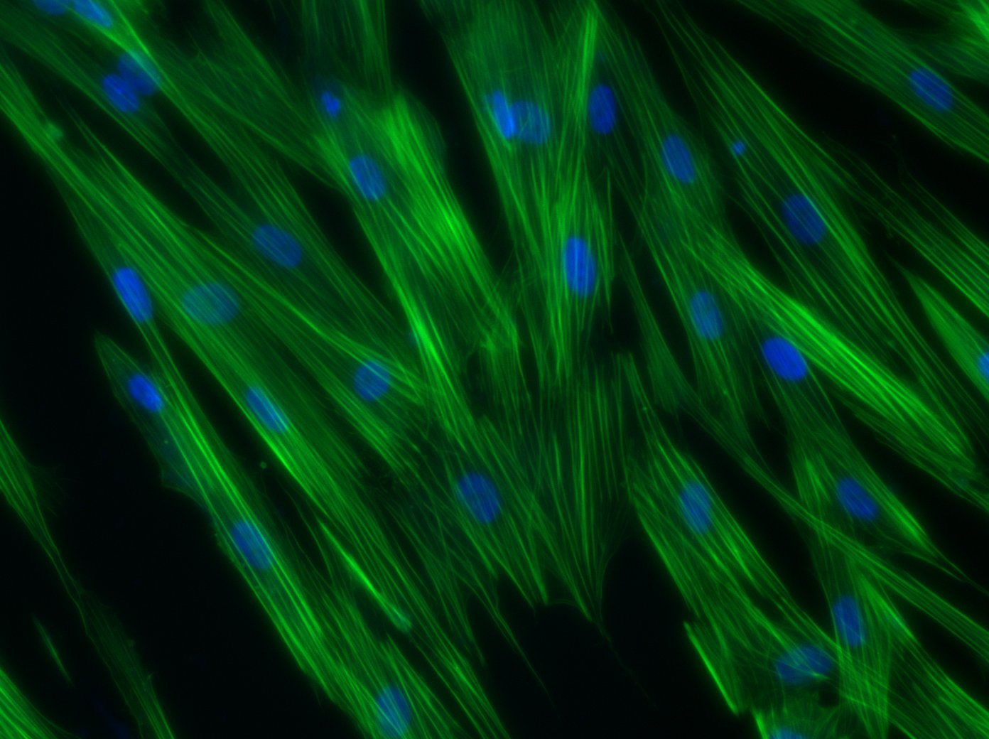
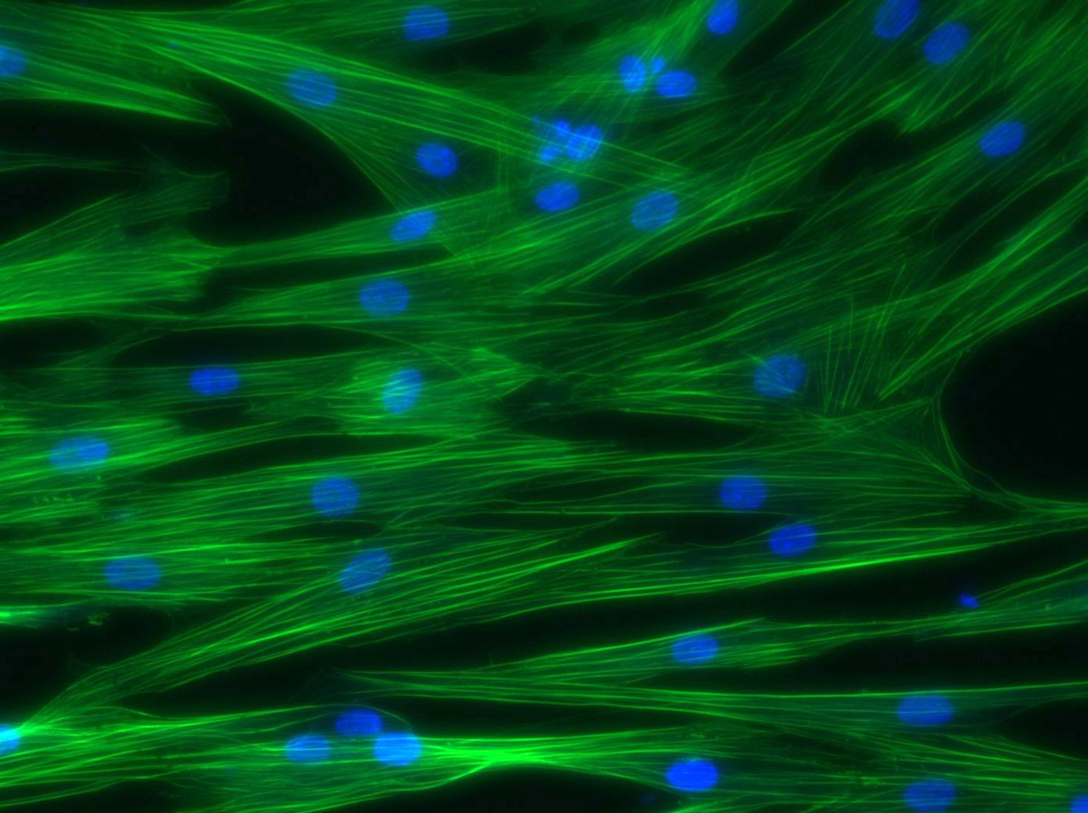
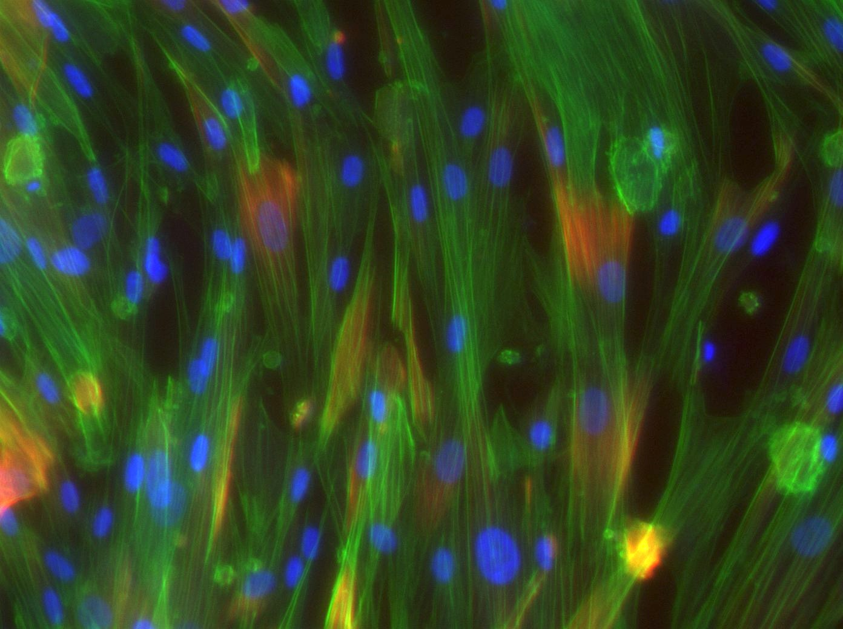
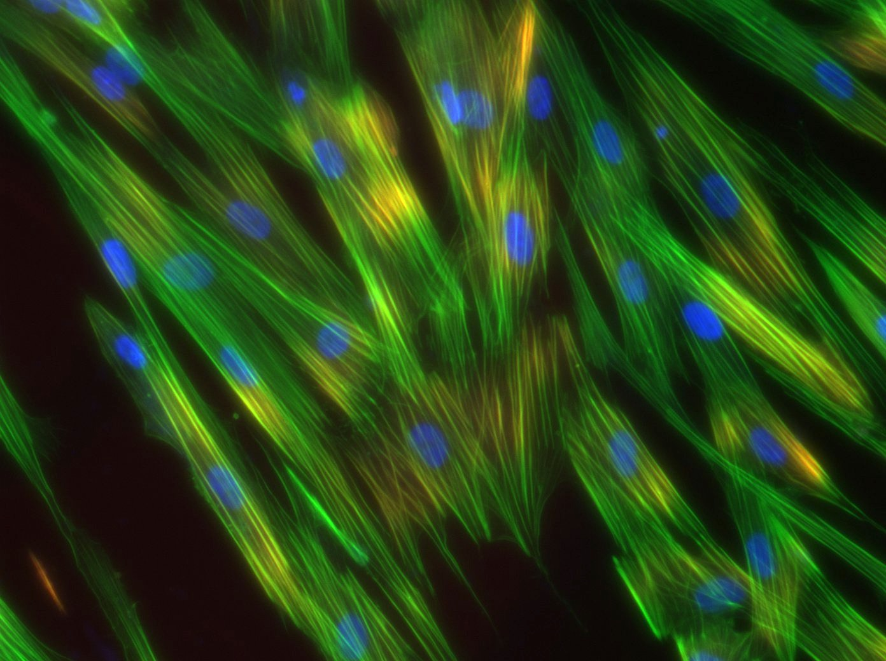
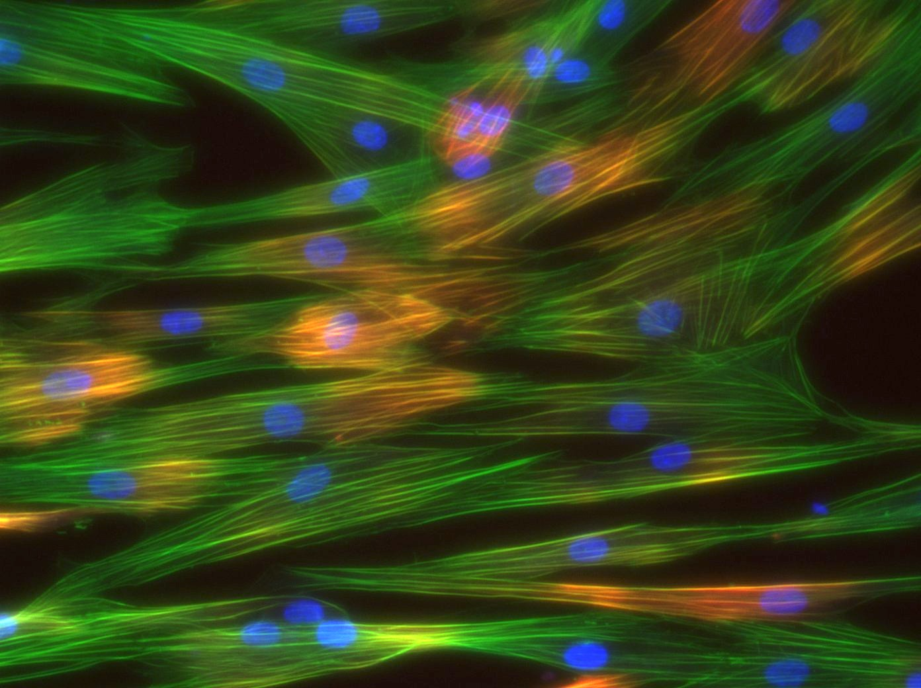
SMC-G
SMC-B
SMC-T
Figure 3. Protein expression of SMC-G, SMC-B, and SMC-T on culture day 4. Images taken at 20X magnification showing expression of calponin (red, top), f-actin (green, middle), DAPI (blue, all), and merged (bottom)
Figure 4. qPCR analysis of SMC-G, SMC-B, and SMC-T on culture day 4. Profiles for α smooth muscle actin (top left), calponin (top middle), smoothelin (top right), elastin (bottom left), cyclin d1 (bottom middle) , *p<0.05 one-way ANOVA

Slide 4
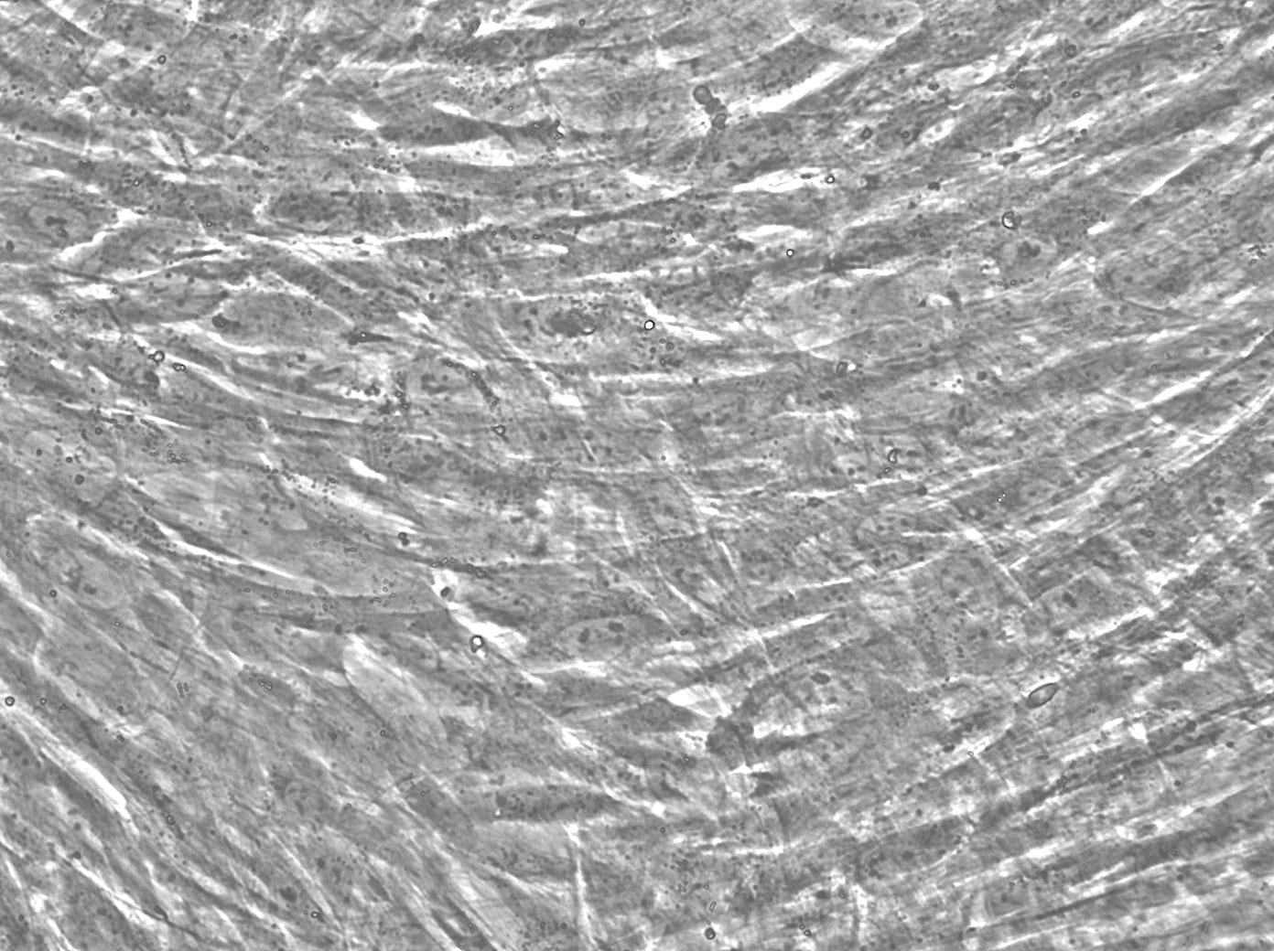
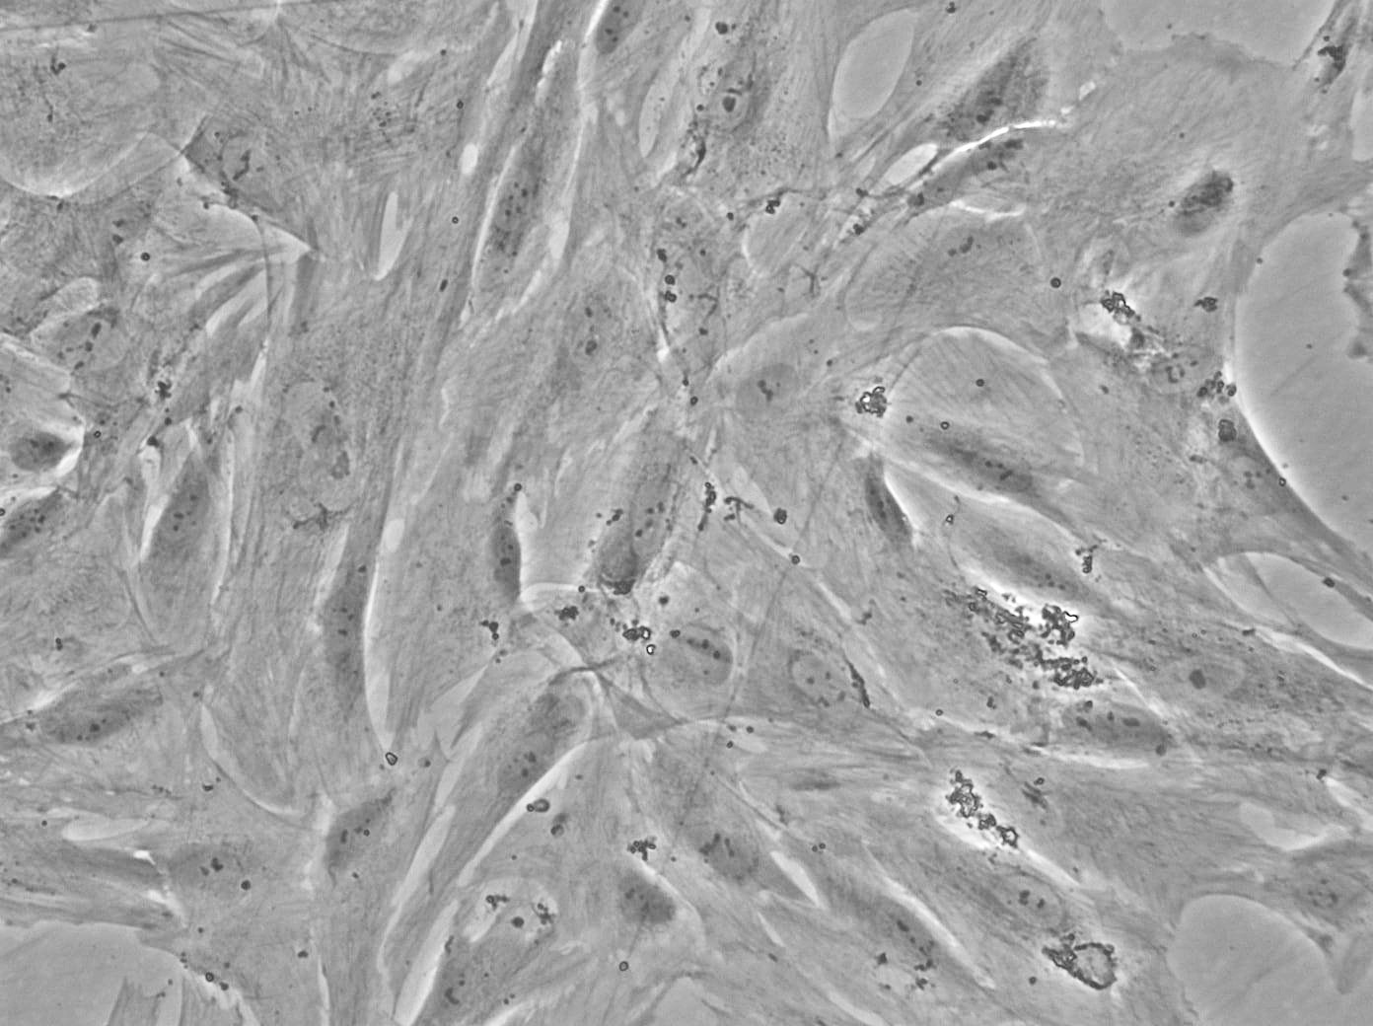
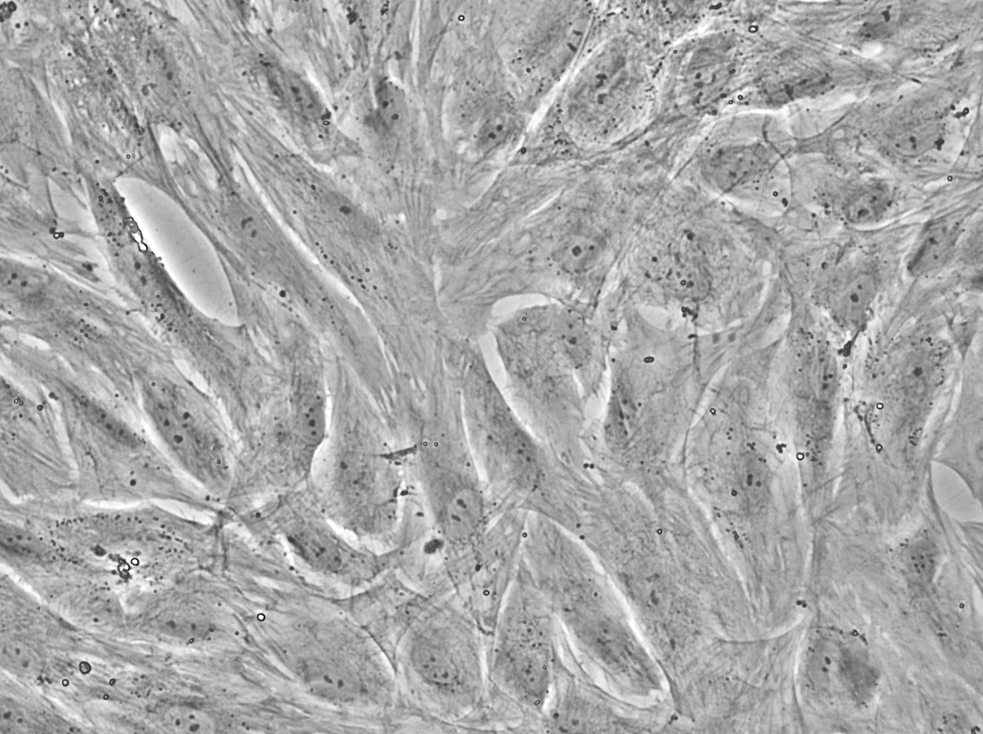
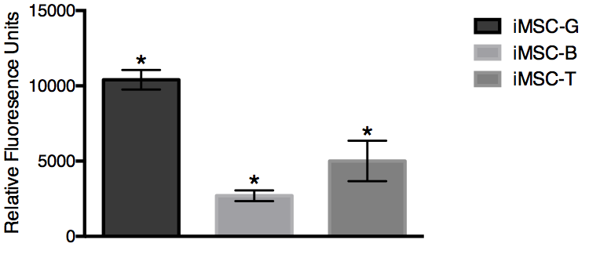
A
iMSC-T
iMSC-G
iMSC-B
B
Figure 5. A) Bright field images of iMSC-G, iMSC-B, and iMSC-T on culture day 4 at 20X magnification. B) Analysis of PrestoBlue assay of iMSC-G, iMSC-B, and iMSC-T, *p<0.05 one-way ANOVA
Notes:
20x BF
Rid lines/chartjunk
20x and RFU 1 fig, EDU images A and then graph B in fig2, protein exp fig 3, gene expression fig 4

Slide 5
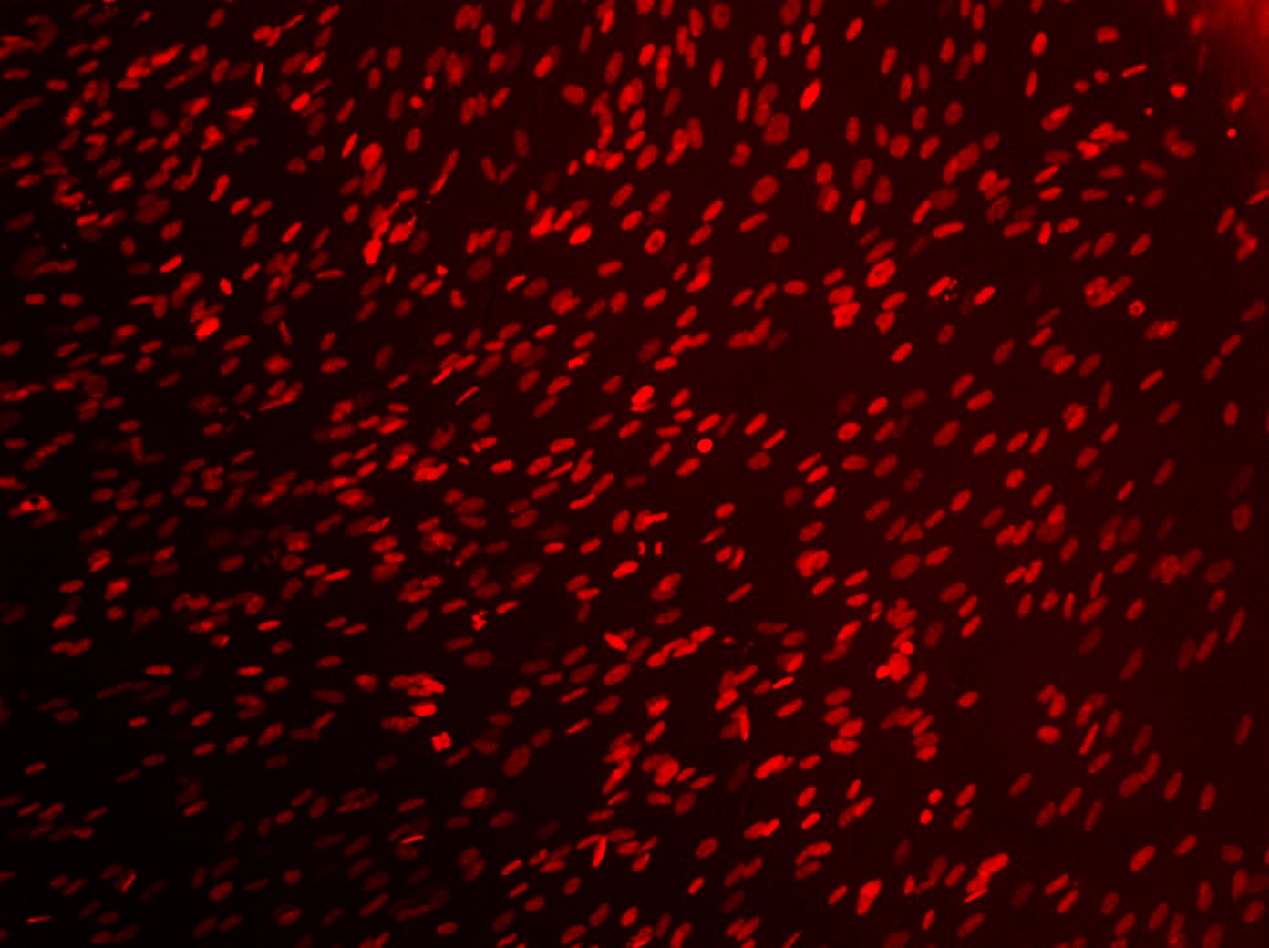
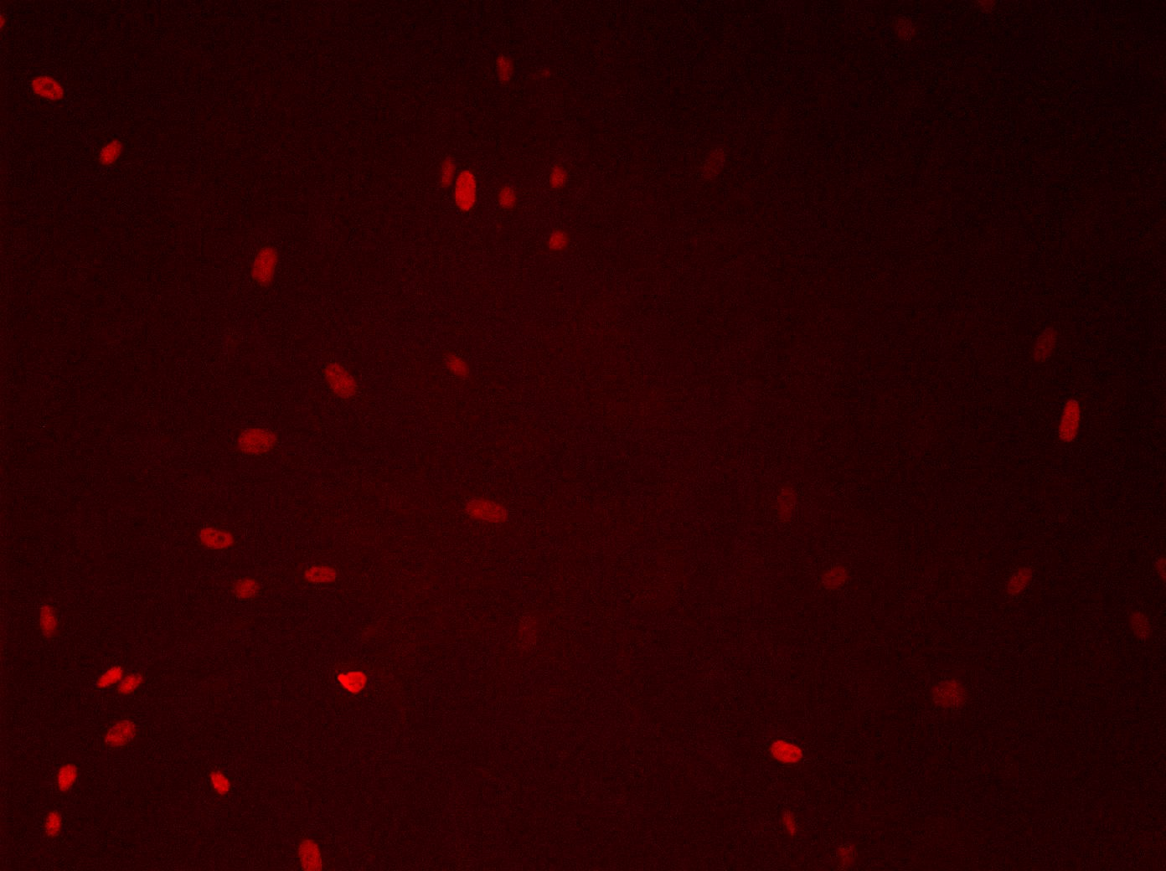
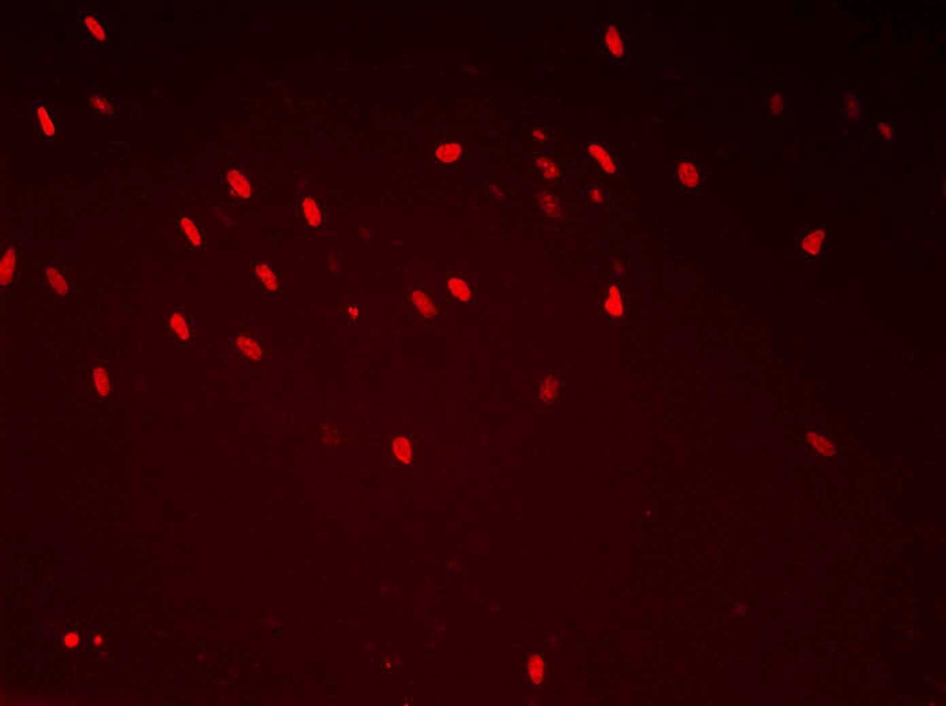
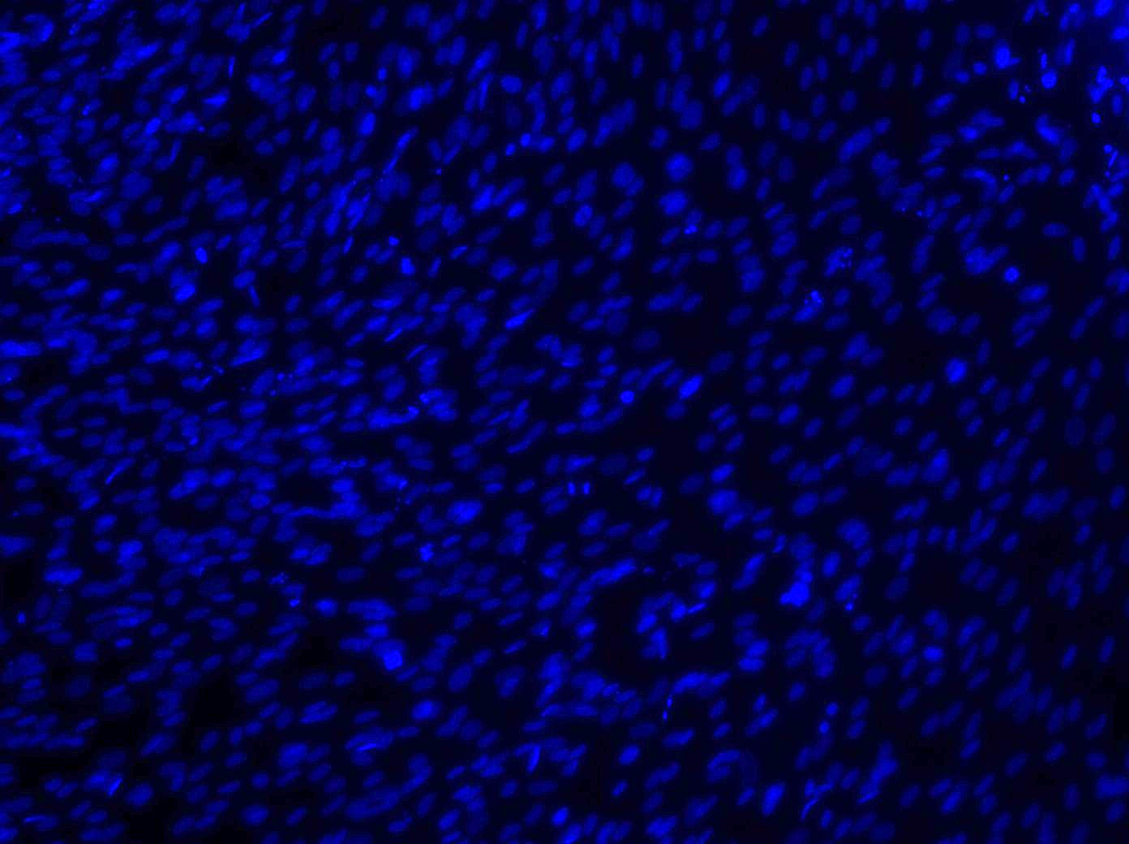
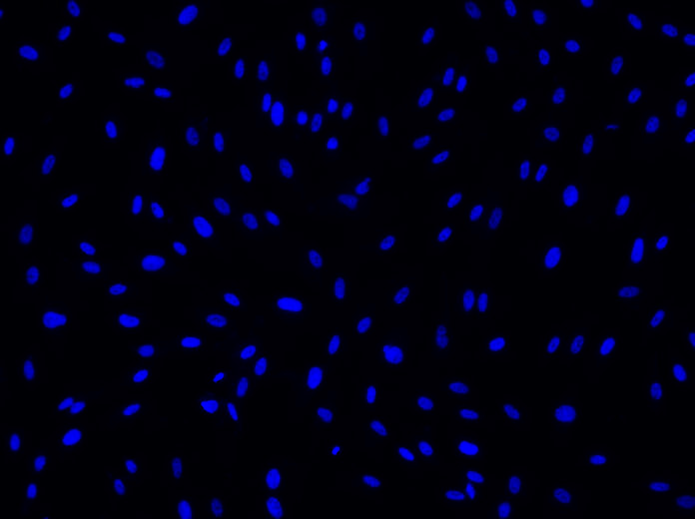
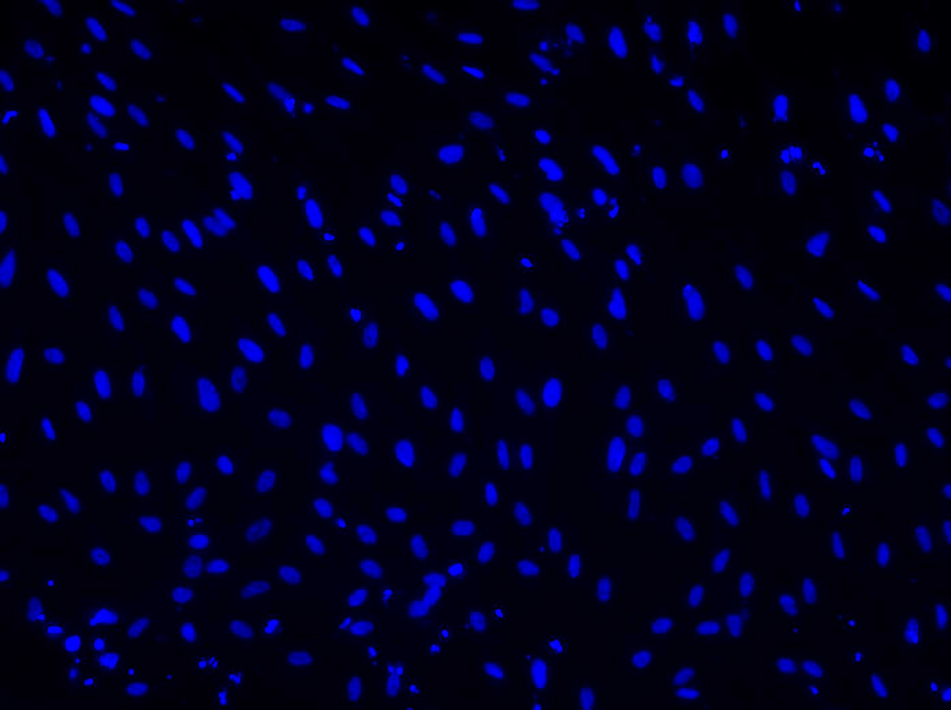
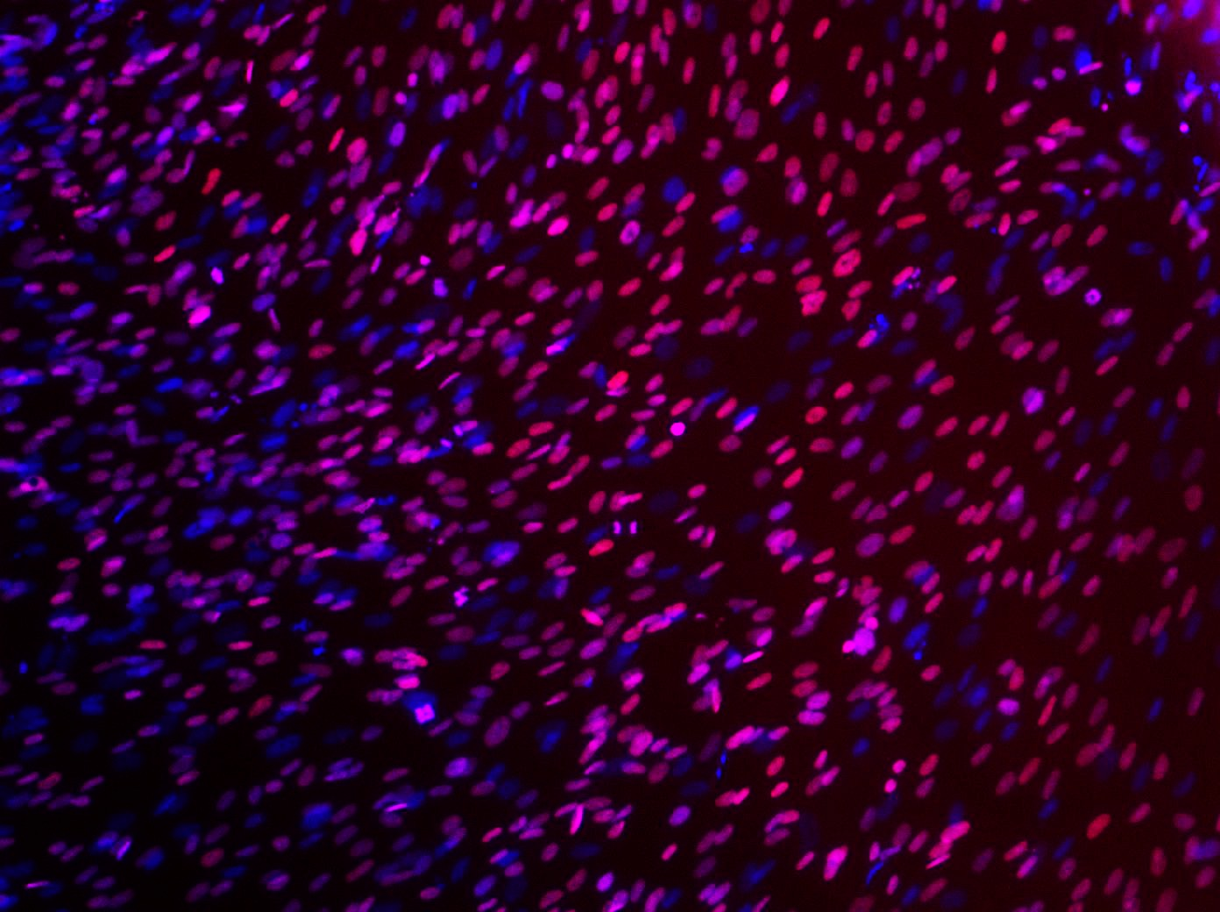
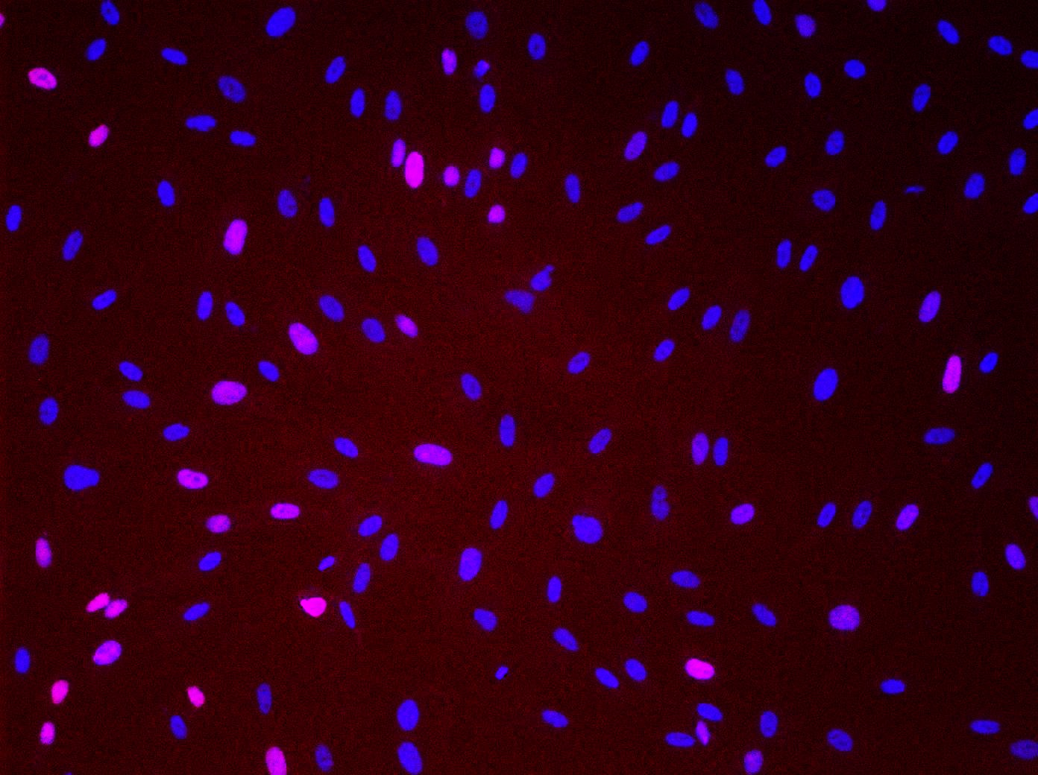
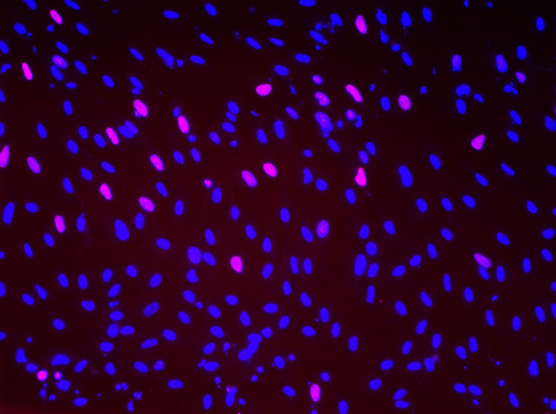
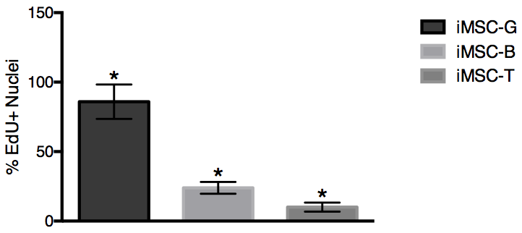
A)
iMSC-G
iMSC-B
iMSC-T
B
Figure 6. EdU assay of iMSC-G, iMSC-B, and iMSC-T on culture day 4. A) Images taken at 10X magnification showing expression of EdU (top), DAPI (middle), and EdU and DAPI merged (bottom). B) Analysis of the percentage of EdU+ nuclei, *p<0.05 one-way ANOVA

Slide 6
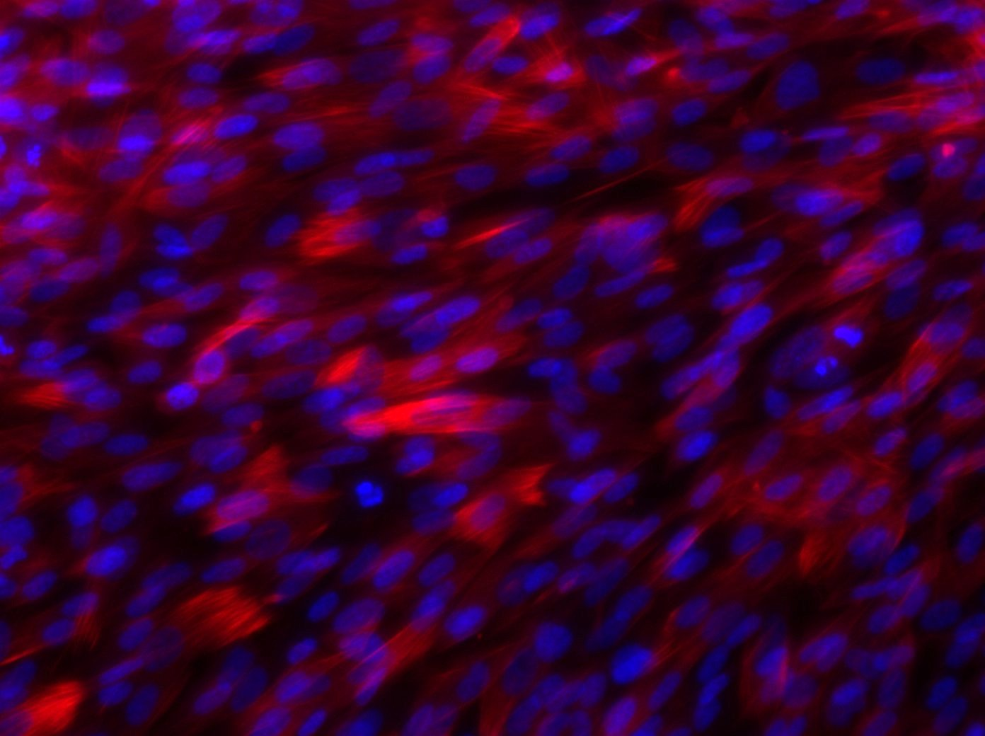
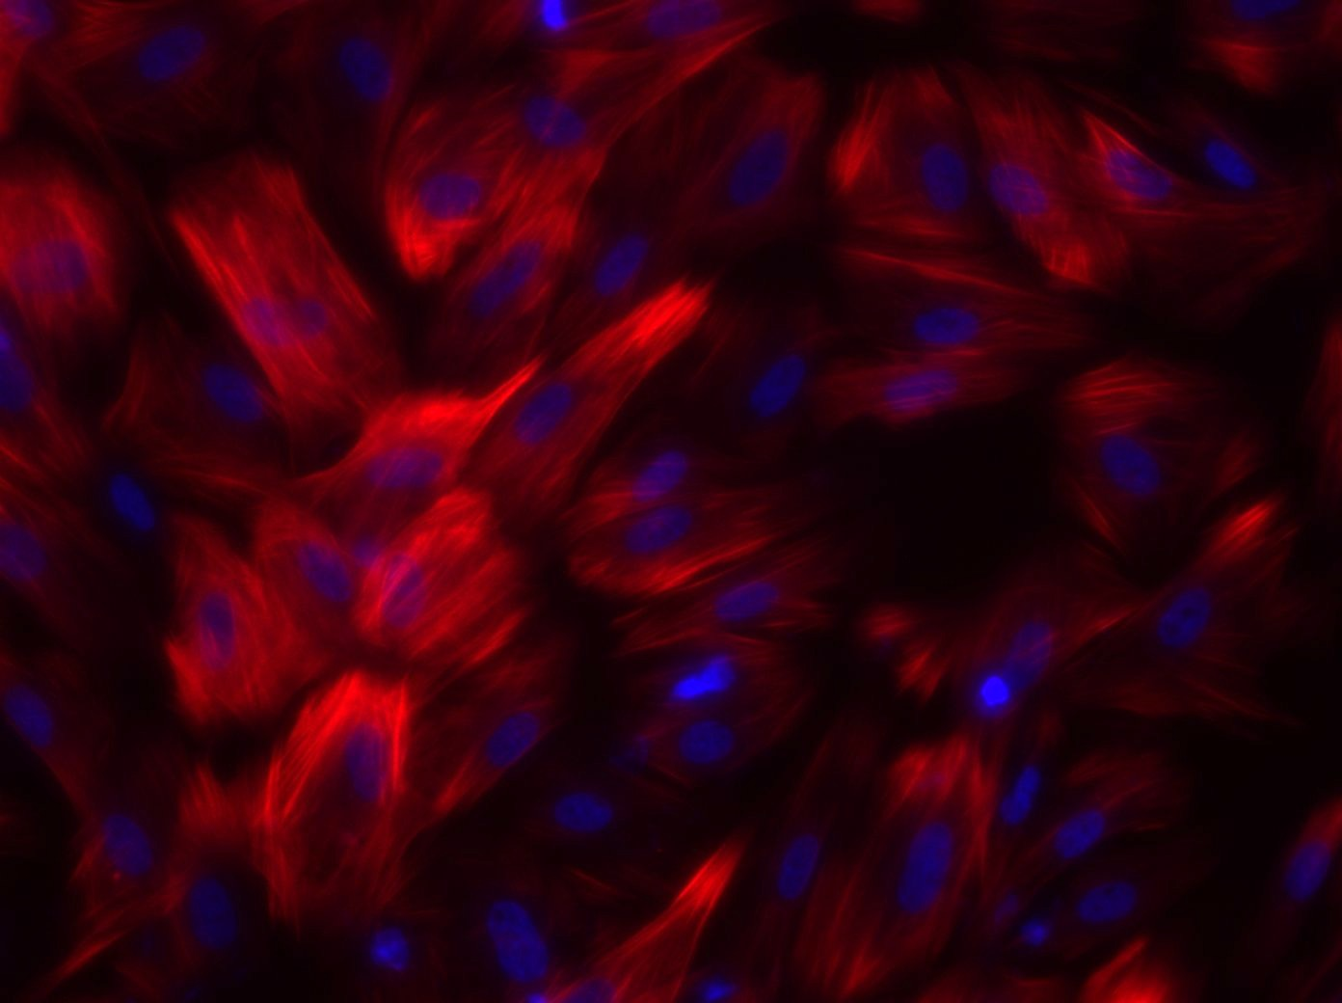
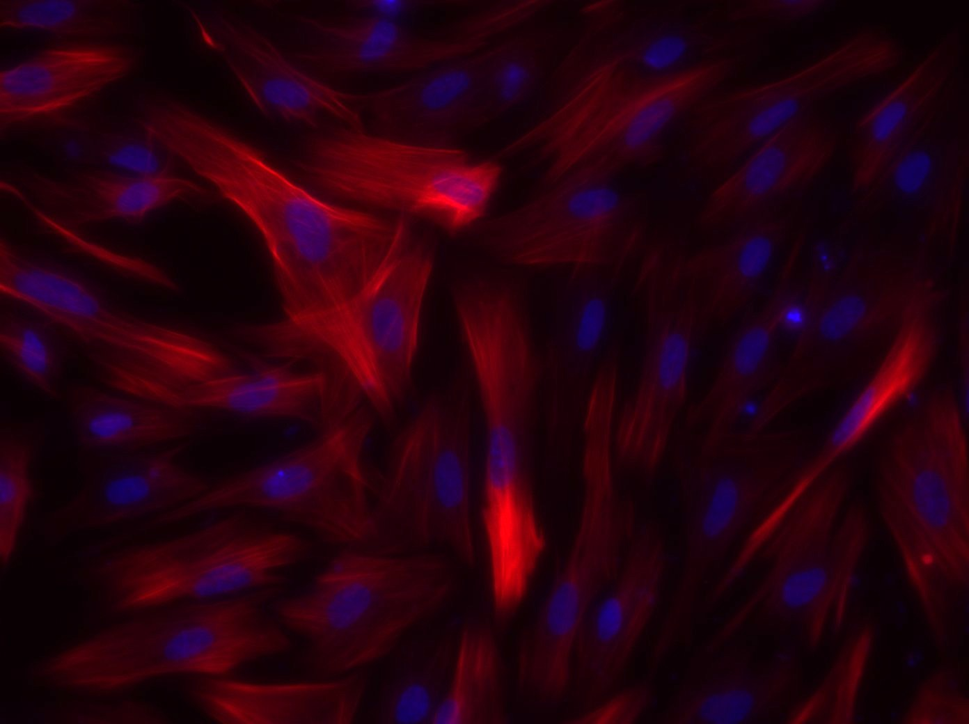
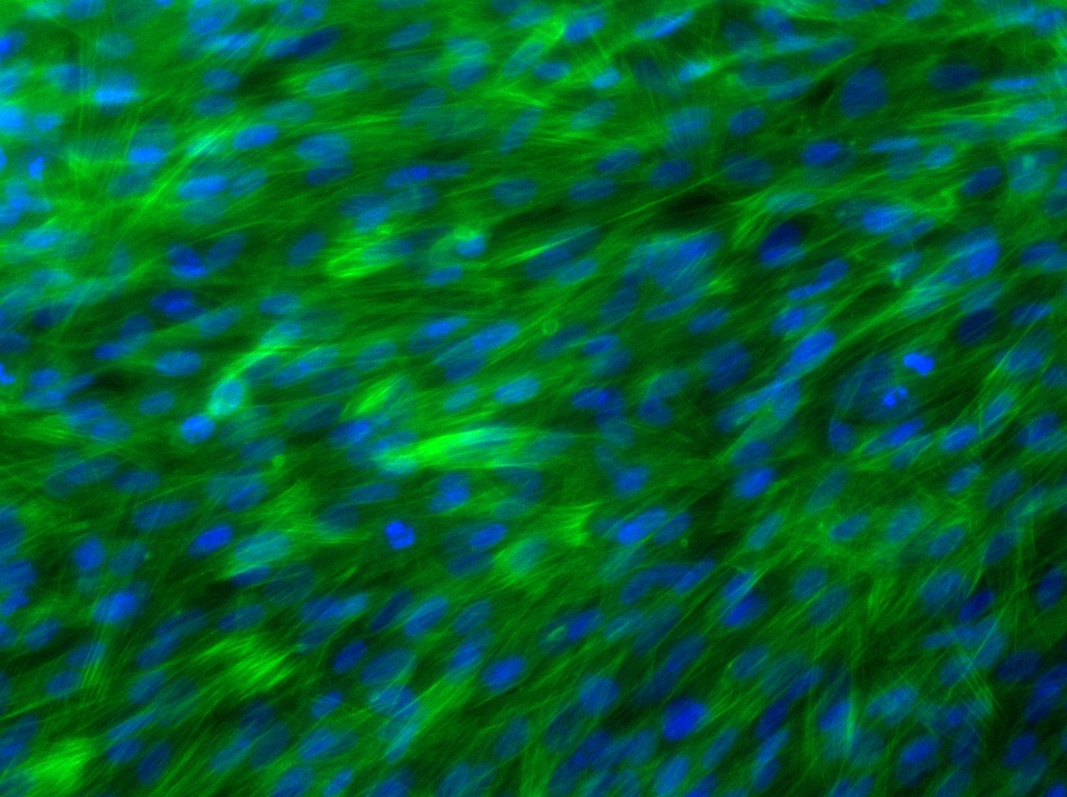
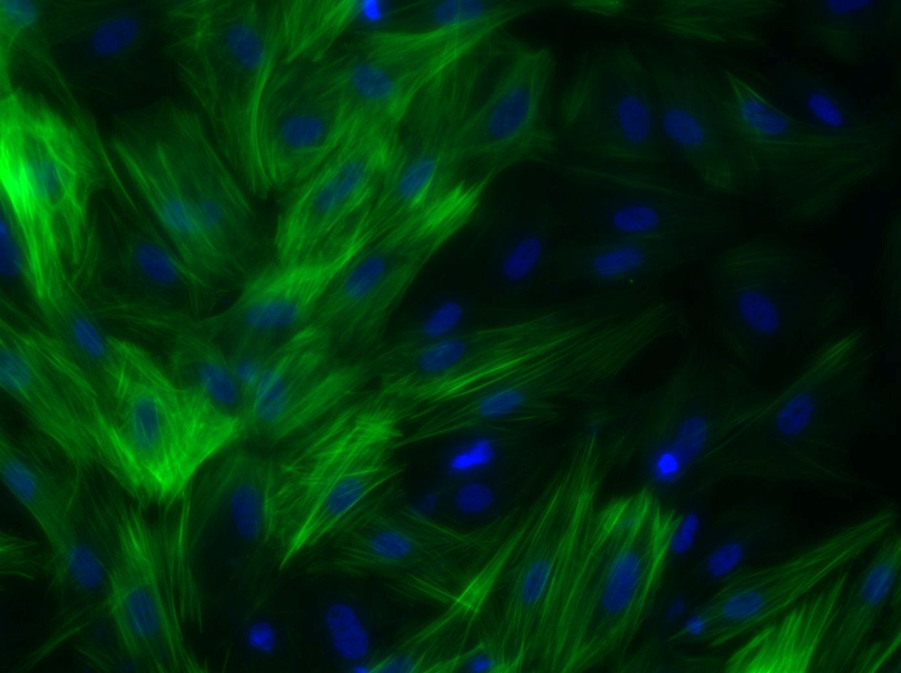
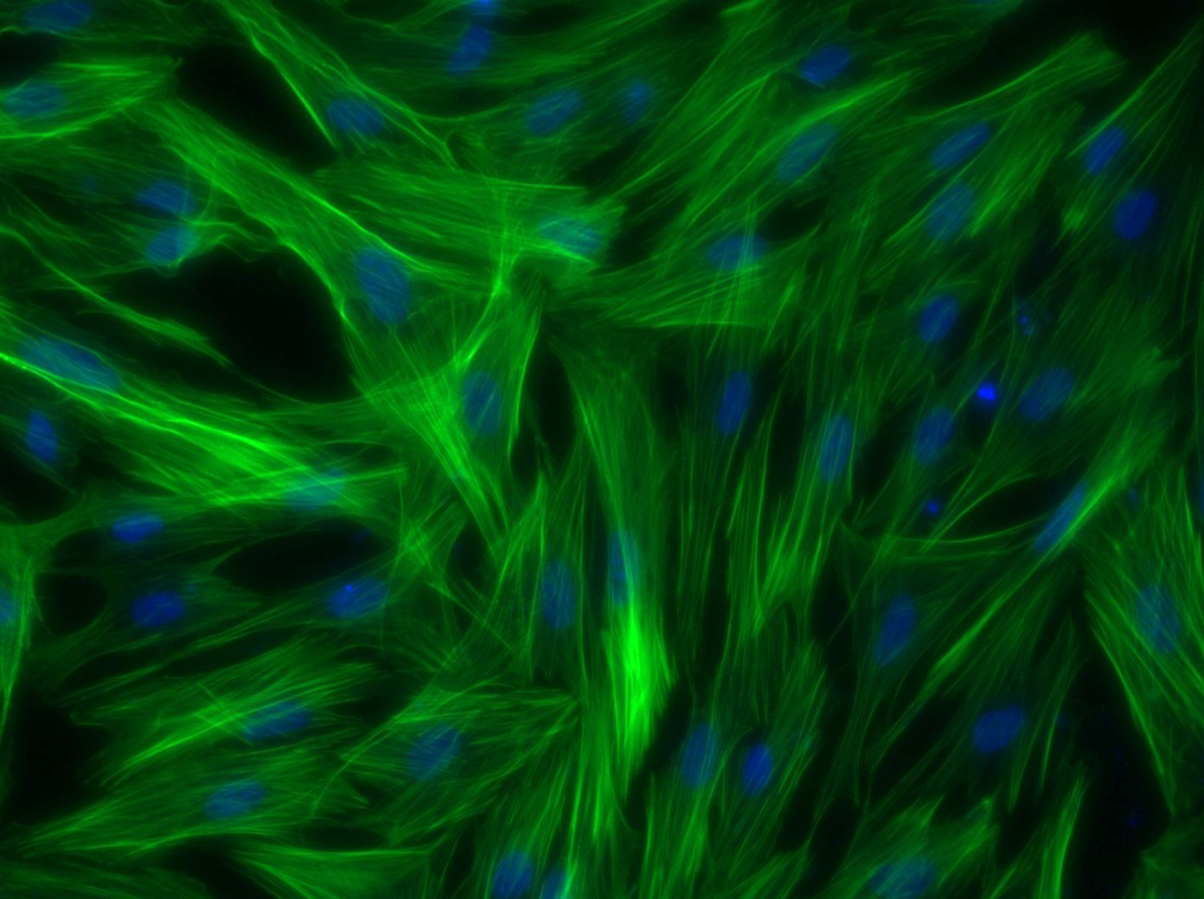
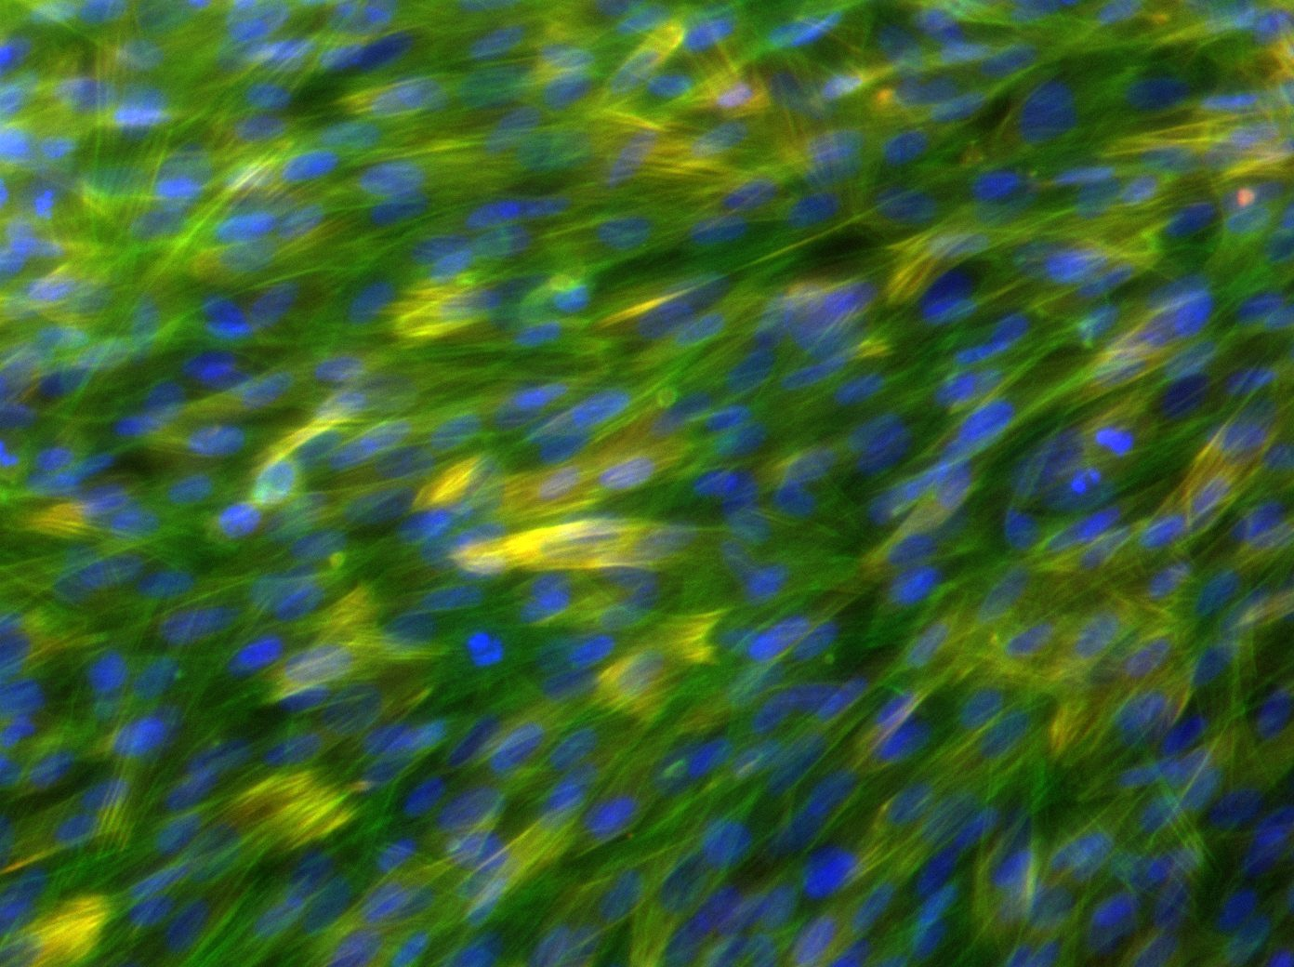
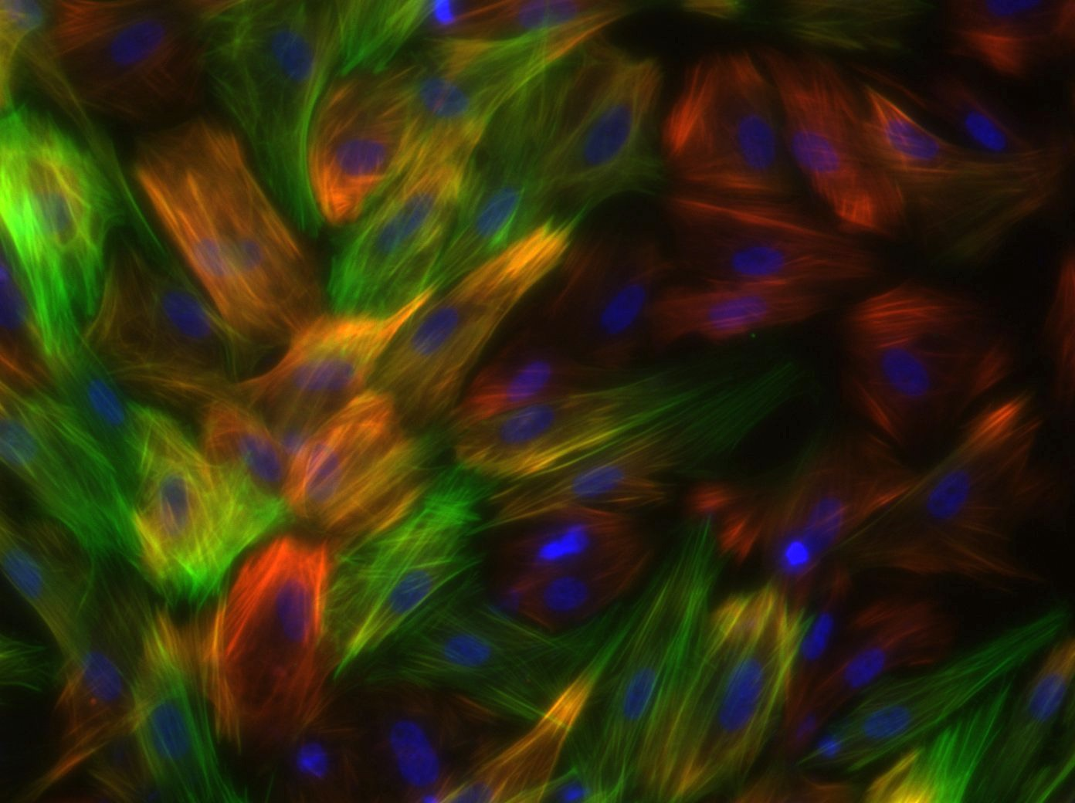
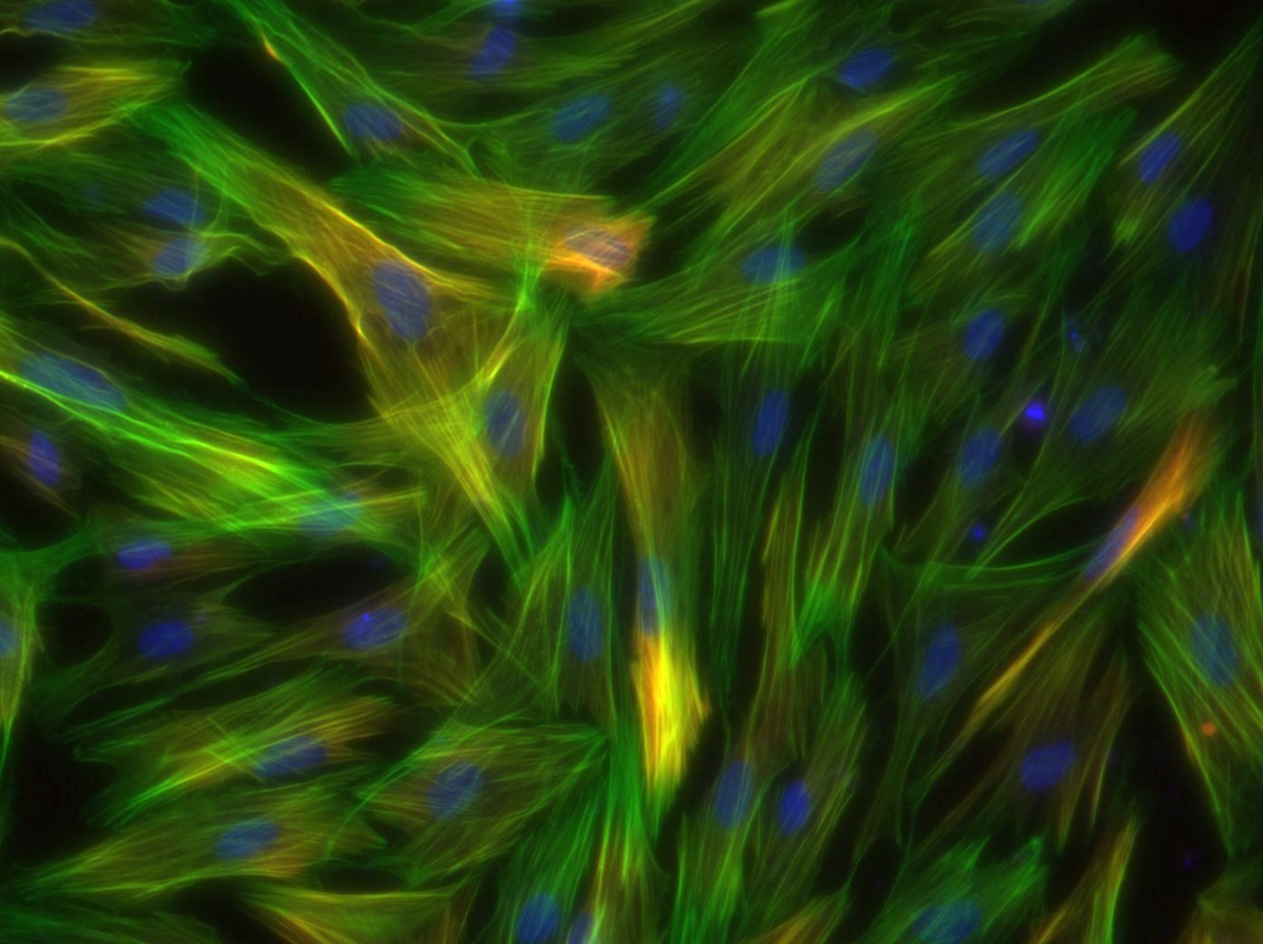
iMSC-G
iMSC-B
iMSC-T
Figure 7. Protein expression of SMC-G, SMC-B, and SMC-T on culture day 4. Images taken at 20X magnification showing expression of calponin (red, top), f-actin (green, middle), DAPI (blue, all), and merged (bottom)
Figure 8. qPCR analysis of SMC-G, SMC-B, and SMC-T on culture day 4. Profiles for α smooth muscle actin (top left), calponin (top middle), smoothelin (top right), elastin (bottom left), cyclin d1 (bottom middle), *p<0.05 one-way ANOVA

Slide 7
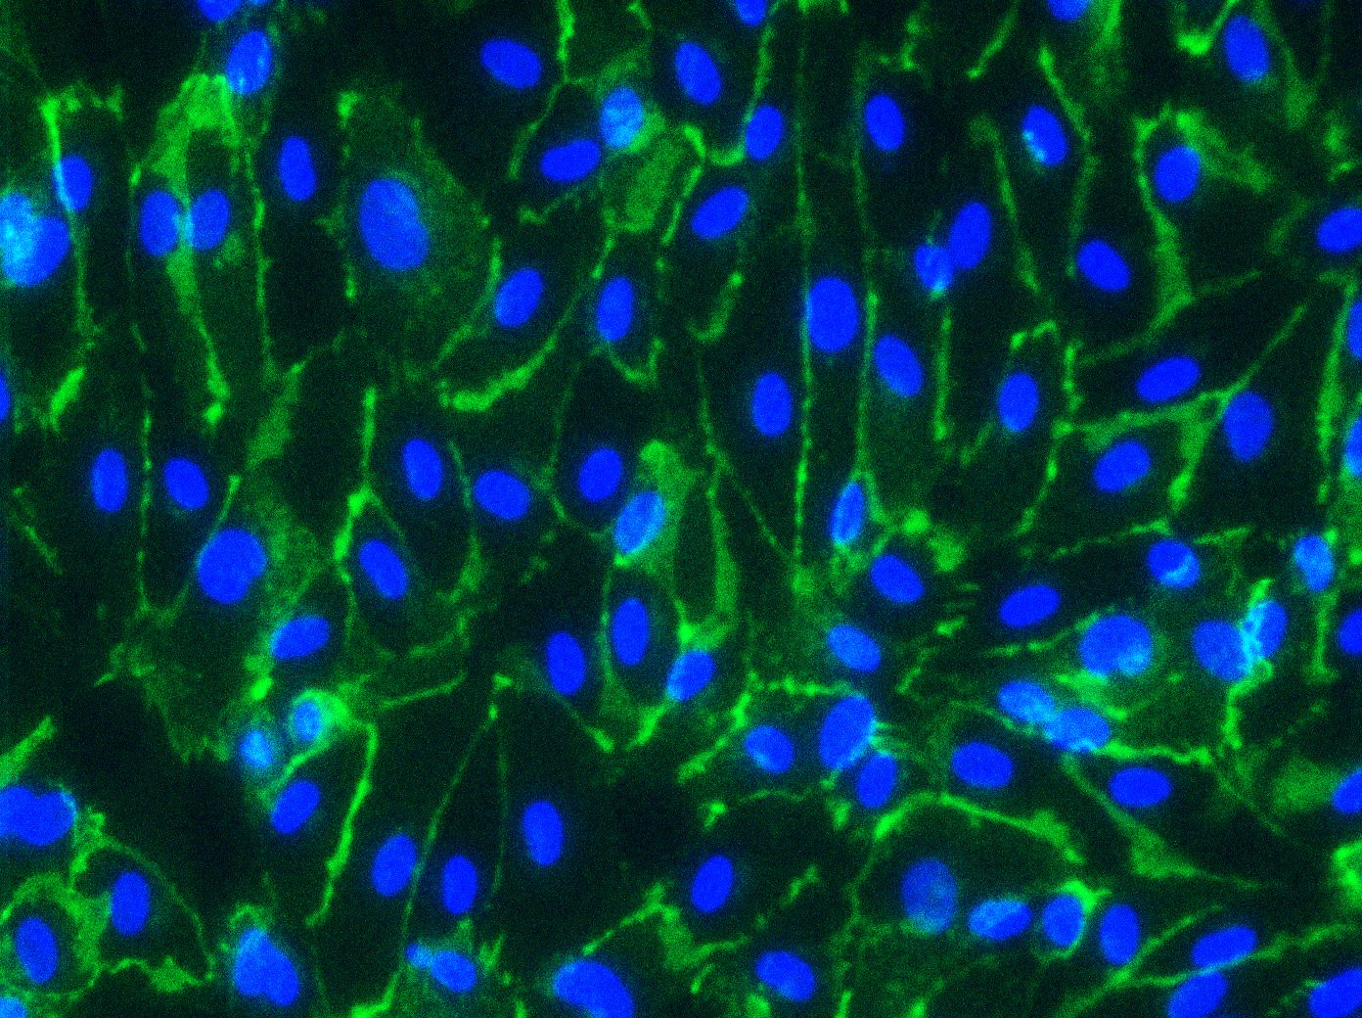












iEC-G
SMC-G-Cond
SMC-B-Cond
SMC-T-Cond
Figure 9. Protein expression of iEC-G, SMC-G-Cond, SMC-B-Cond, and SMC-T-Cond on culture day 3 (top) and culture day 6 (bottom). Images taken at 20X magnification showing expression of VE-cadherin (green) and DAPI (blue).
Figure 10. Analysis of TEER readings of iEC Monolayer, SMC-G/iEC Monolayer, SMC-B/iEC Monolayer, and SMC-T/iEC Monolayer on culture day 6,*p<0.05 one-way ANOVA
iEC
Monolayer
SMC-G/iEC Bilayer
SMC-B/iEC Bilayer
SMC-T/iEC Bilayer
Figure 11. Protein expression of iEC Monolayer, SMC-G/iEC Monolayer, SMC-B/iEC Monolayer, and SMC-T/iEC Monolayer on culture day 13. Images taken at 20X magnification showing expression of ZO-1 (red) and DAPI (blue)

Slide 8







iEC-G
iMSC-G-Cond
iMSC-T-Cond
Figure 12. Protein expression of iEC-G, iMSC-G-Cond, iMSC-B-Cond, and iMSC-T-Cond on culture day 3 (top) and culture day 6 (bottom). Images taken at 20X magnification showing expression of VE-cadherin (green) and DAPI (blue).
Figure 13. Analysis of TEER readings of iEC Monolayer, iMSC-G/iEC Monolayer, iMSC-B/iEC Monolayer, and iMSC-T/iEC Monolayer on culture day 6,*p<0.05 one-way ANOVA
iEC
Monolayer
iMSC-G/iEC Bilayer
iMSC-T/iEC Bilayer
Figure 14. Protein expression of iEC Monolayer, iMSC-G/iEC Monolayer, iMSC-B/iEC Monolayer, and iMSC-T/iEC Monolayer on culture day 13. Images taken at 20X magnification showing expression of ZO-1 (red) and DAPI (blue)

